Slide 1
Introduction to Computing for Data Analysis
Linear regression
Richard Vuduc, Ph.D.
Associate Professor
School of Computational Science and Engineering
Gradients and residual minimization
Notes:
In the previous lesson, you formulated the multiple linear regression problem as one of minimizing the residual.
In this lesson, let’s see how to compute that minimum.

Slide 2
Introduction to Computing for Data Analysis
Linear regression
Richard Vuduc, Ph.D.
Associate Professor
School of Computational Science and Engineering
Gradients and residual minimization
Notes:
To do so, you’ll need the vector analogue of “taking the first derivative.”
That mathematical tool is something called the gradient.
So let’s see how it works and then apply it.

Slide 3
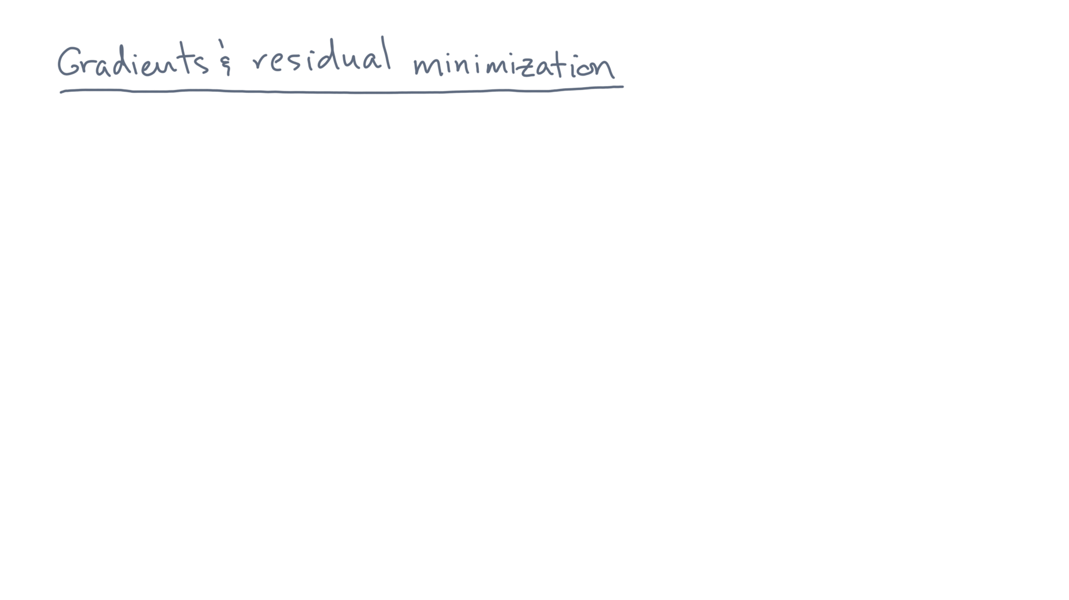
Notes:
Let’s suppose you have a vector variable, theta.

Slide 4
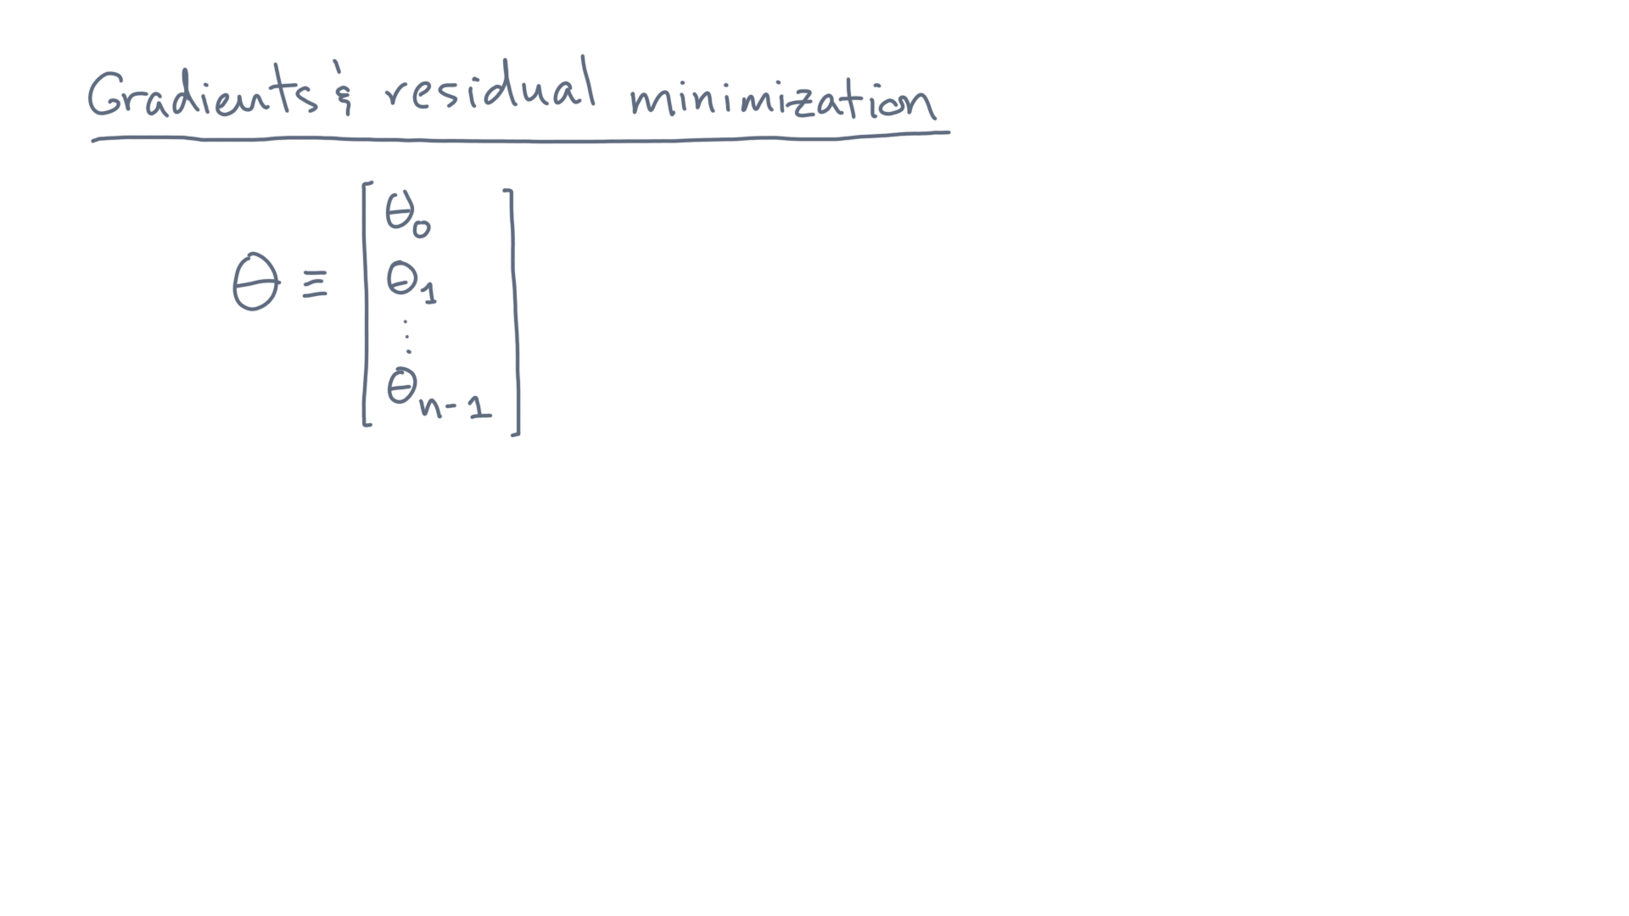
Notes:
Let’s say it has “n” components, theta-zero through theta-n-minus-one.

Slide 5
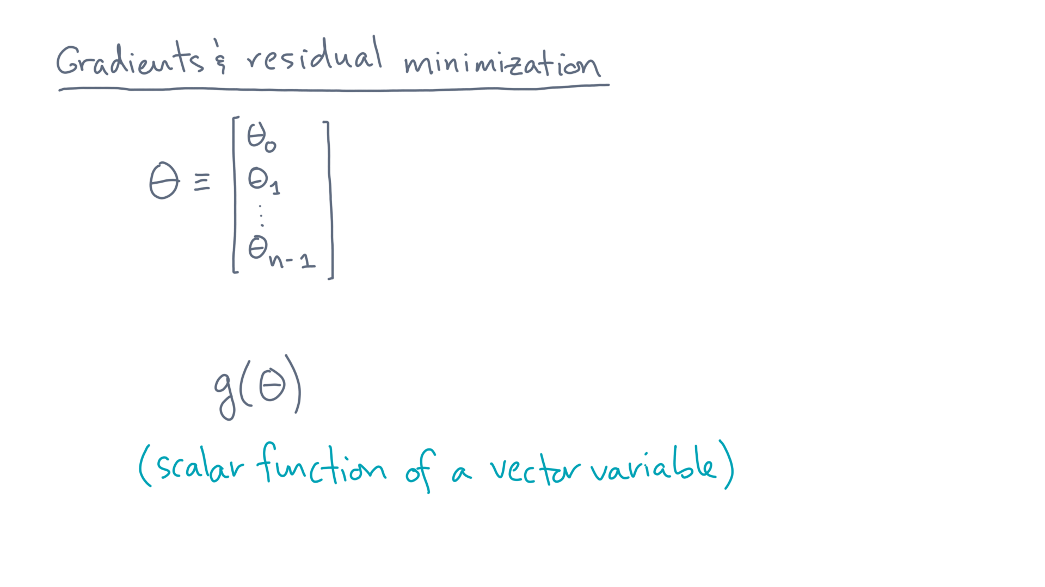
Notes:
Let’s further suppose you are given some *scalar* function of theta, g-of-theta.
That means g produces a scalar, or single (as opposed to vector) value.

Slide 6
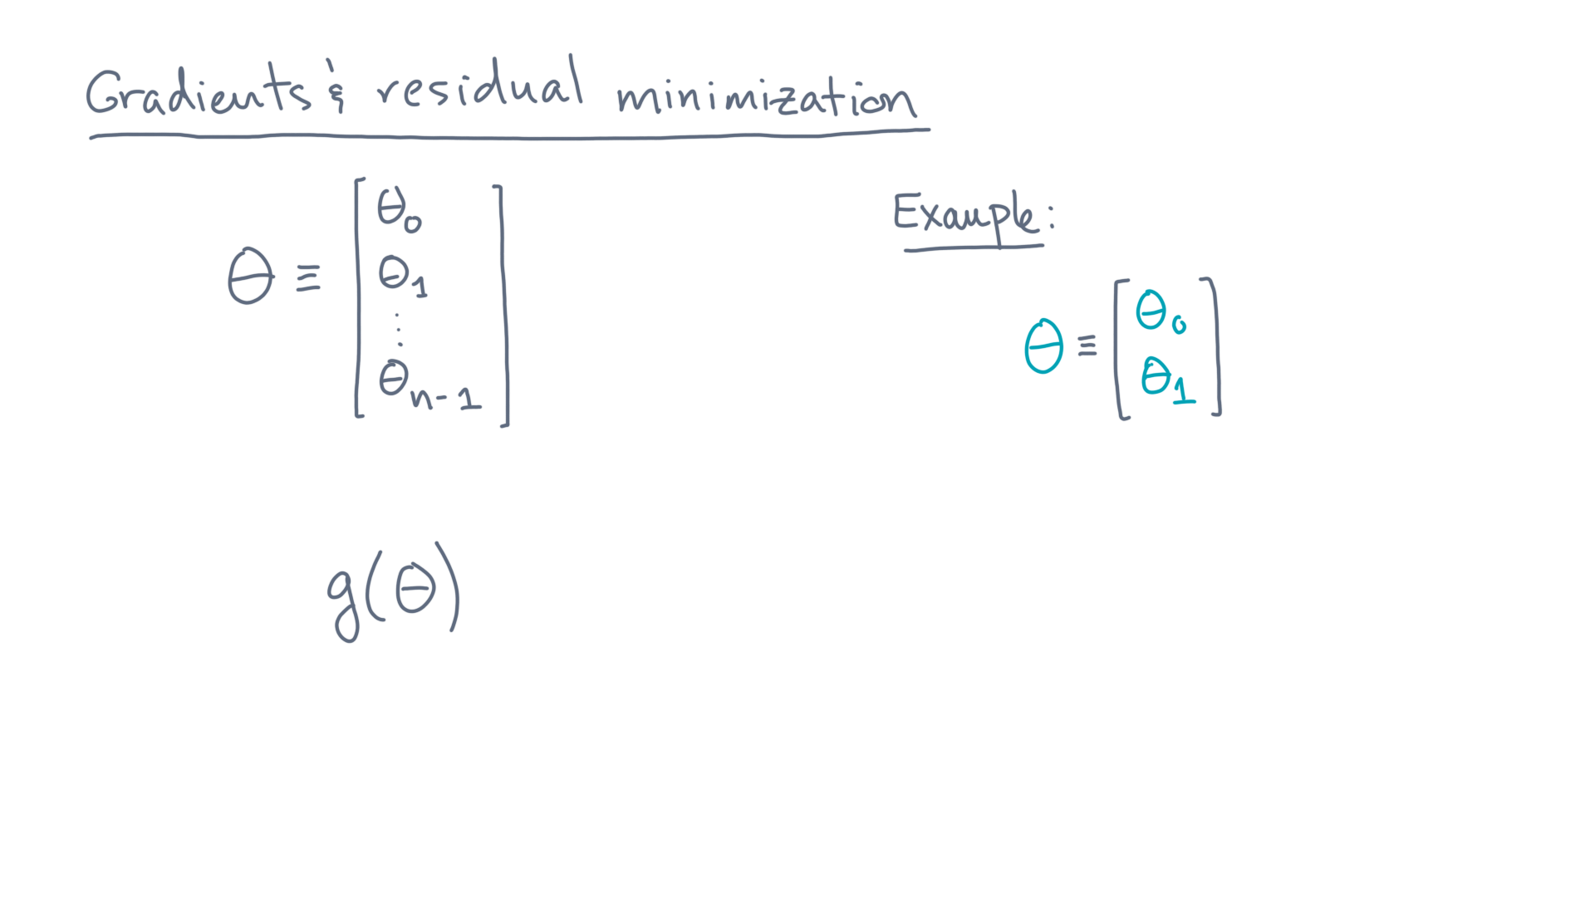
Notes:
For instance, let’s say theta is a vector of length 2.

Slide 7
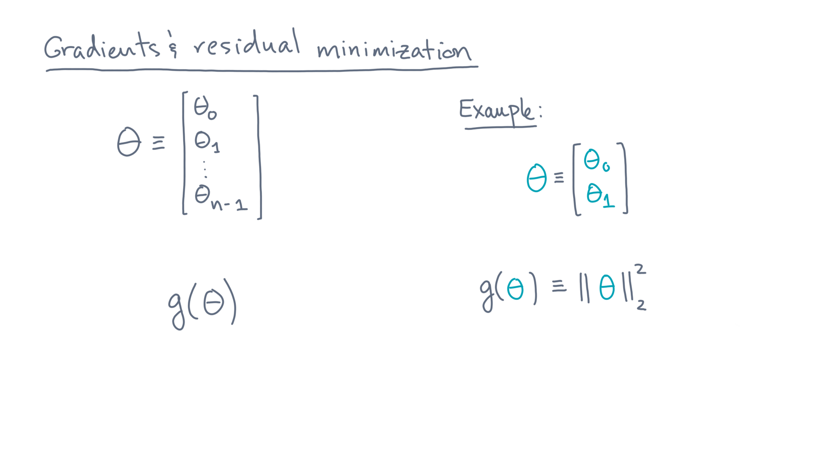
Notes:
And let’s say g-of-theta is the two-norm of theta-squared.
This right-hand side is just a single number, or scalar.

Slide 8
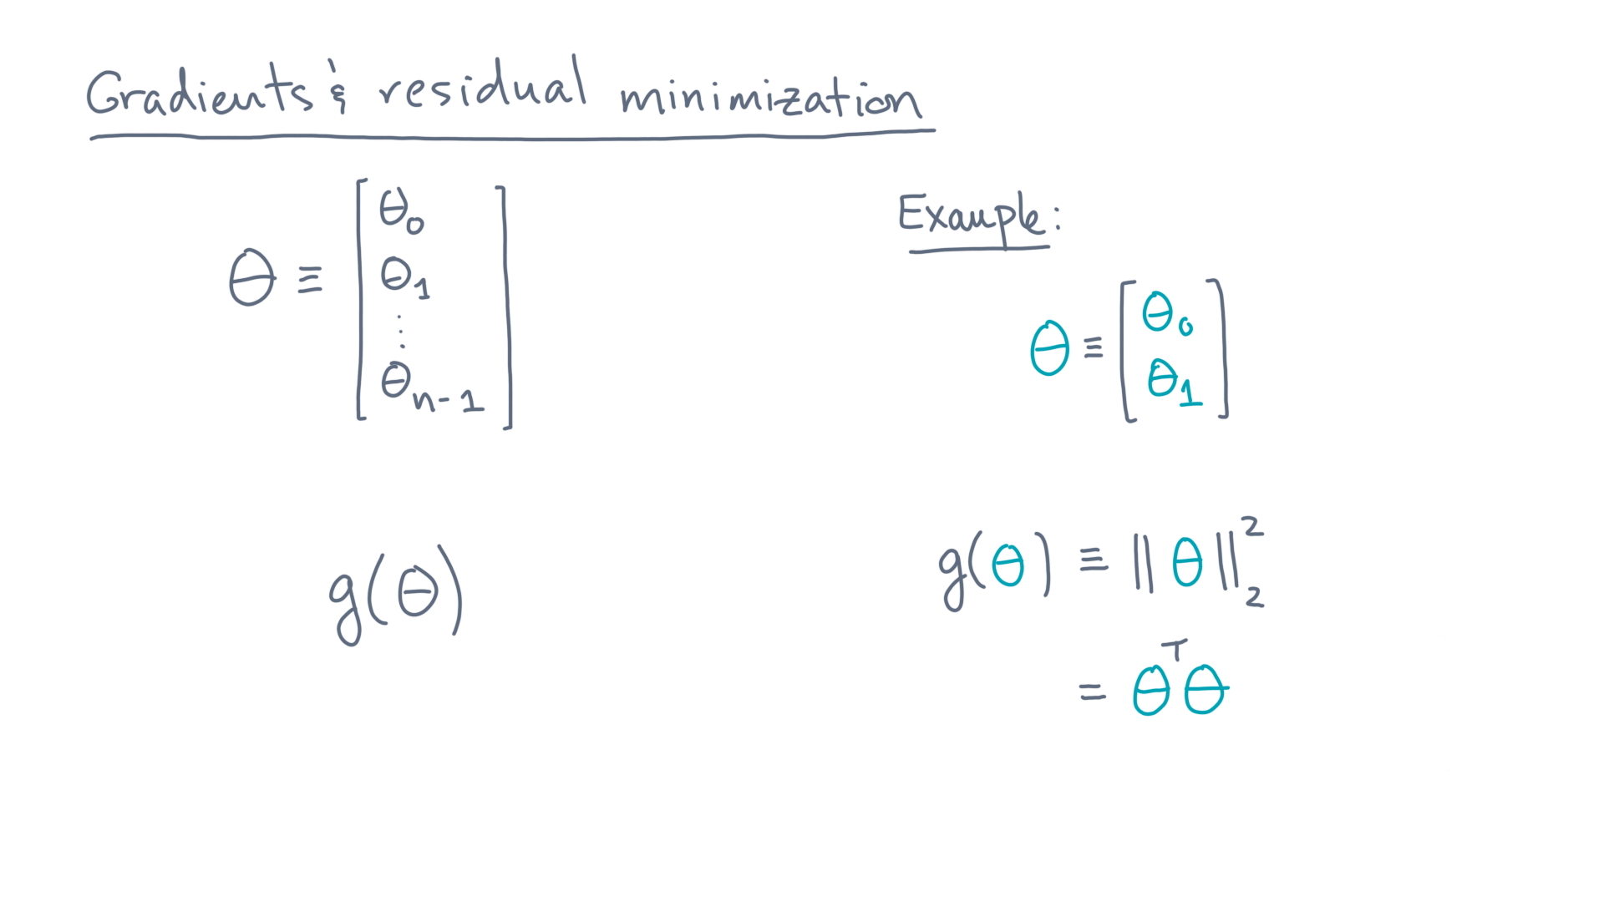
Notes:
Indeed, from the definition of the two-norm, gee is theta-transpose-times-theta.

Slide 9
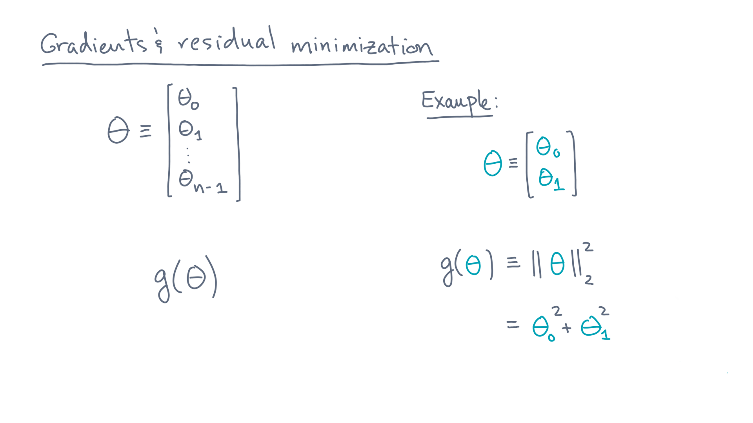
Notes:
In this case, that’s theta-zero-squared plus theta-one-squared.

Slide 10
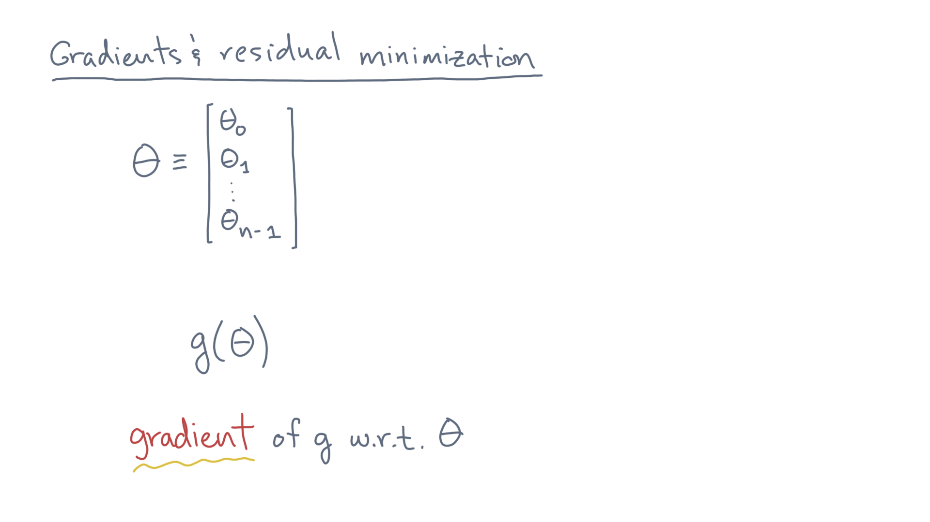
Notes:
Next, let’s define the *gradient* of gee with respect to theta.

Slide 11
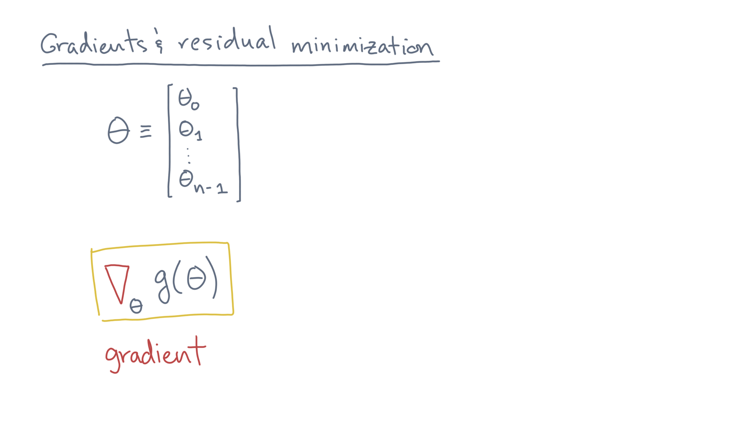
Notes:
Let’s denote it by the nabla, or upside-down triangle, sub-theta, applied to gee.

Slide 12
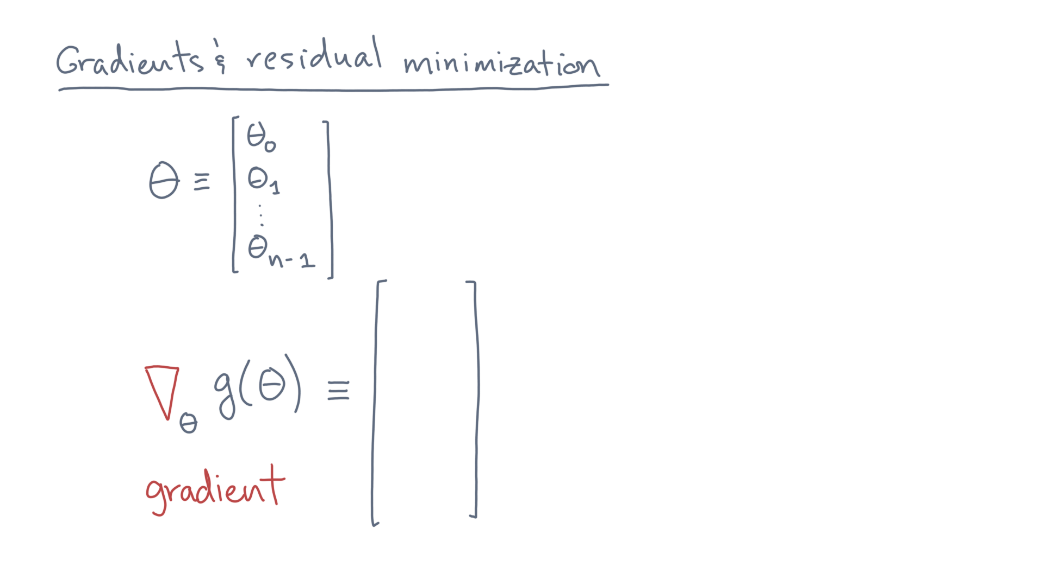
Notes:
And let’s define it to be a vector.

Slide 13
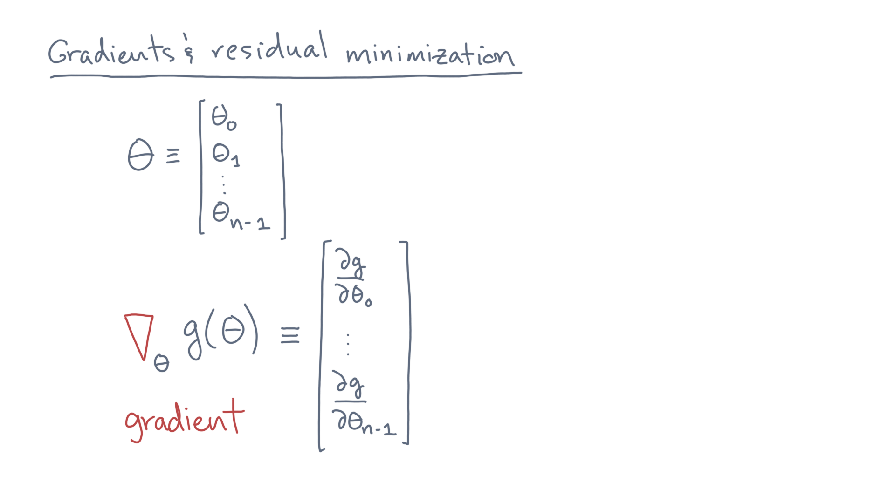
Notes:
Each element of this vector is a partial derivative of gee with respect to some element of theta.

Slide 14
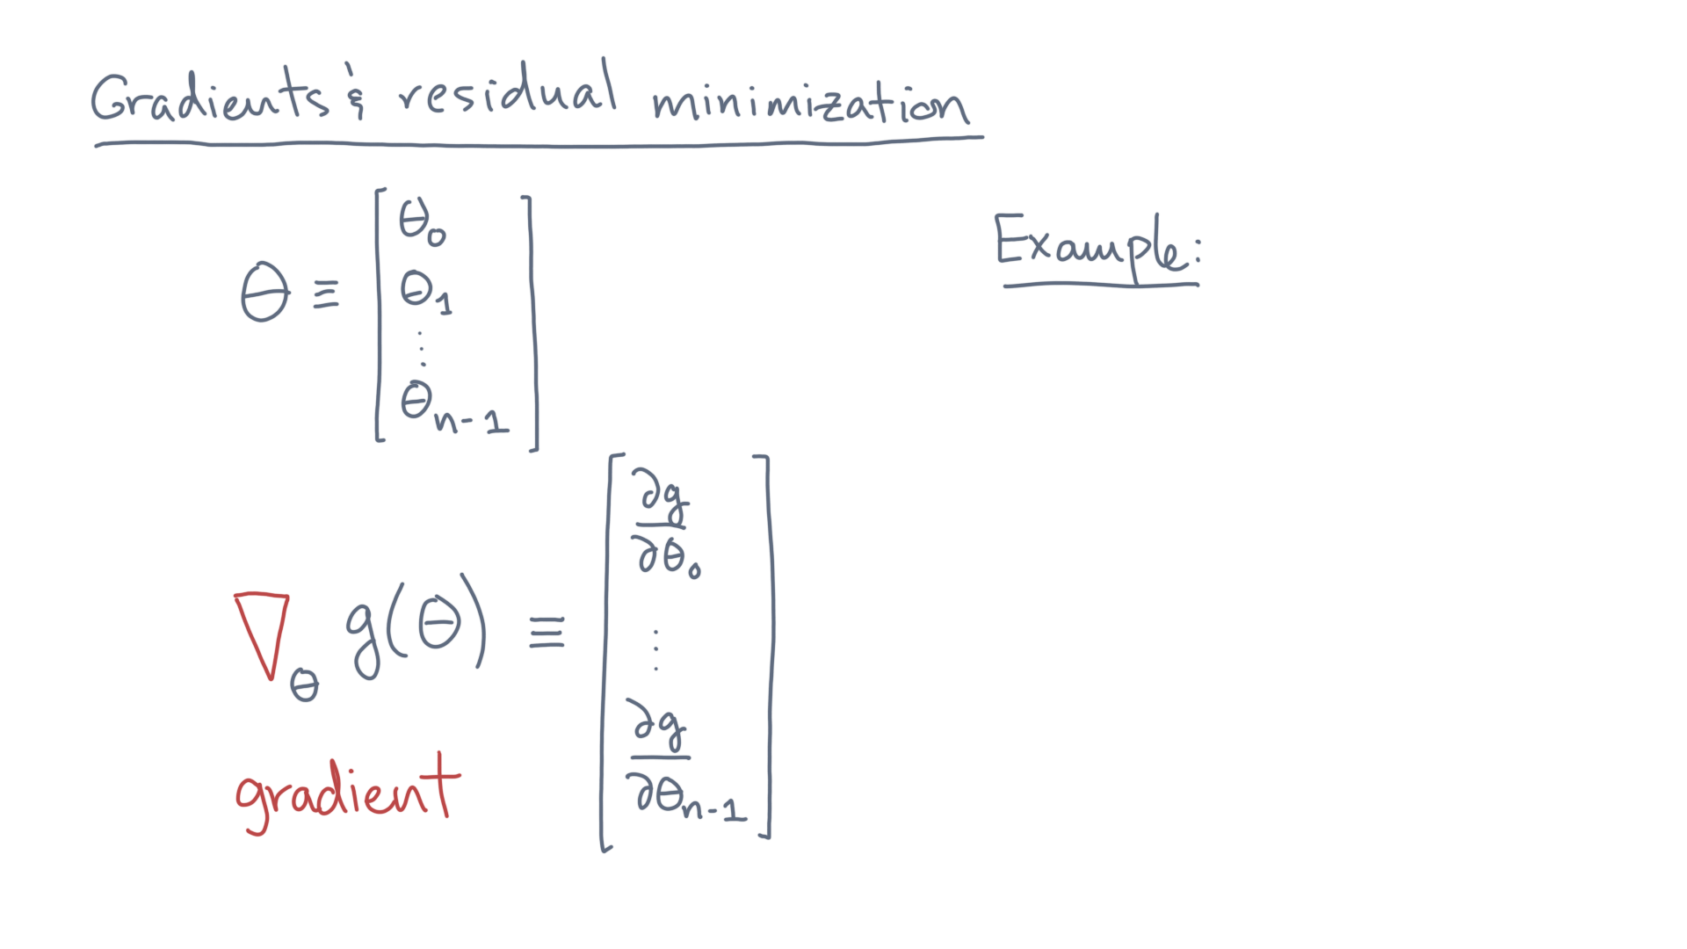
Notes:
Let’s revisit our previous example.

Slide 15
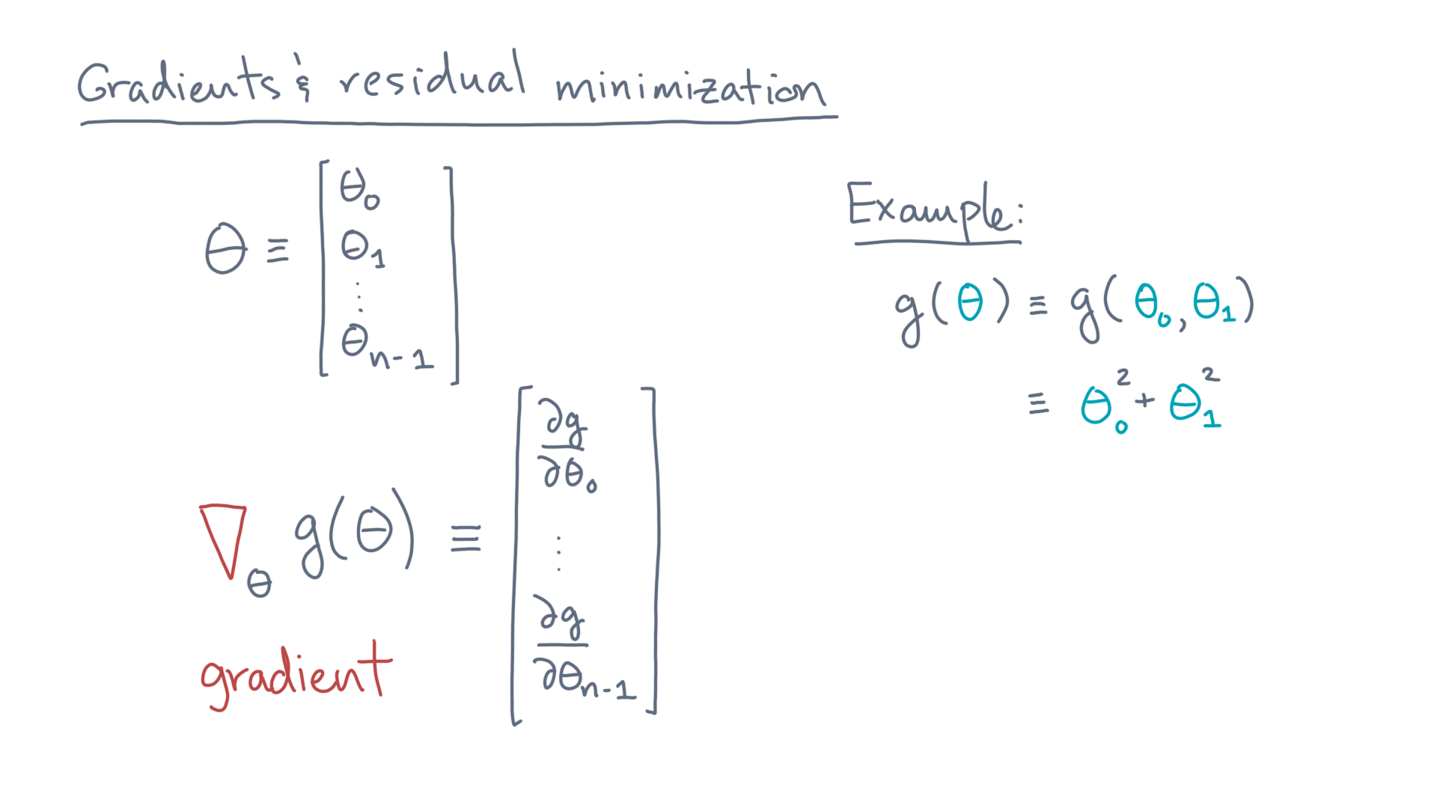
Notes:
There, theta was two-dimensional and gee-of-theta was theta-zero-squared plus theta-one-squared.

Slide 16
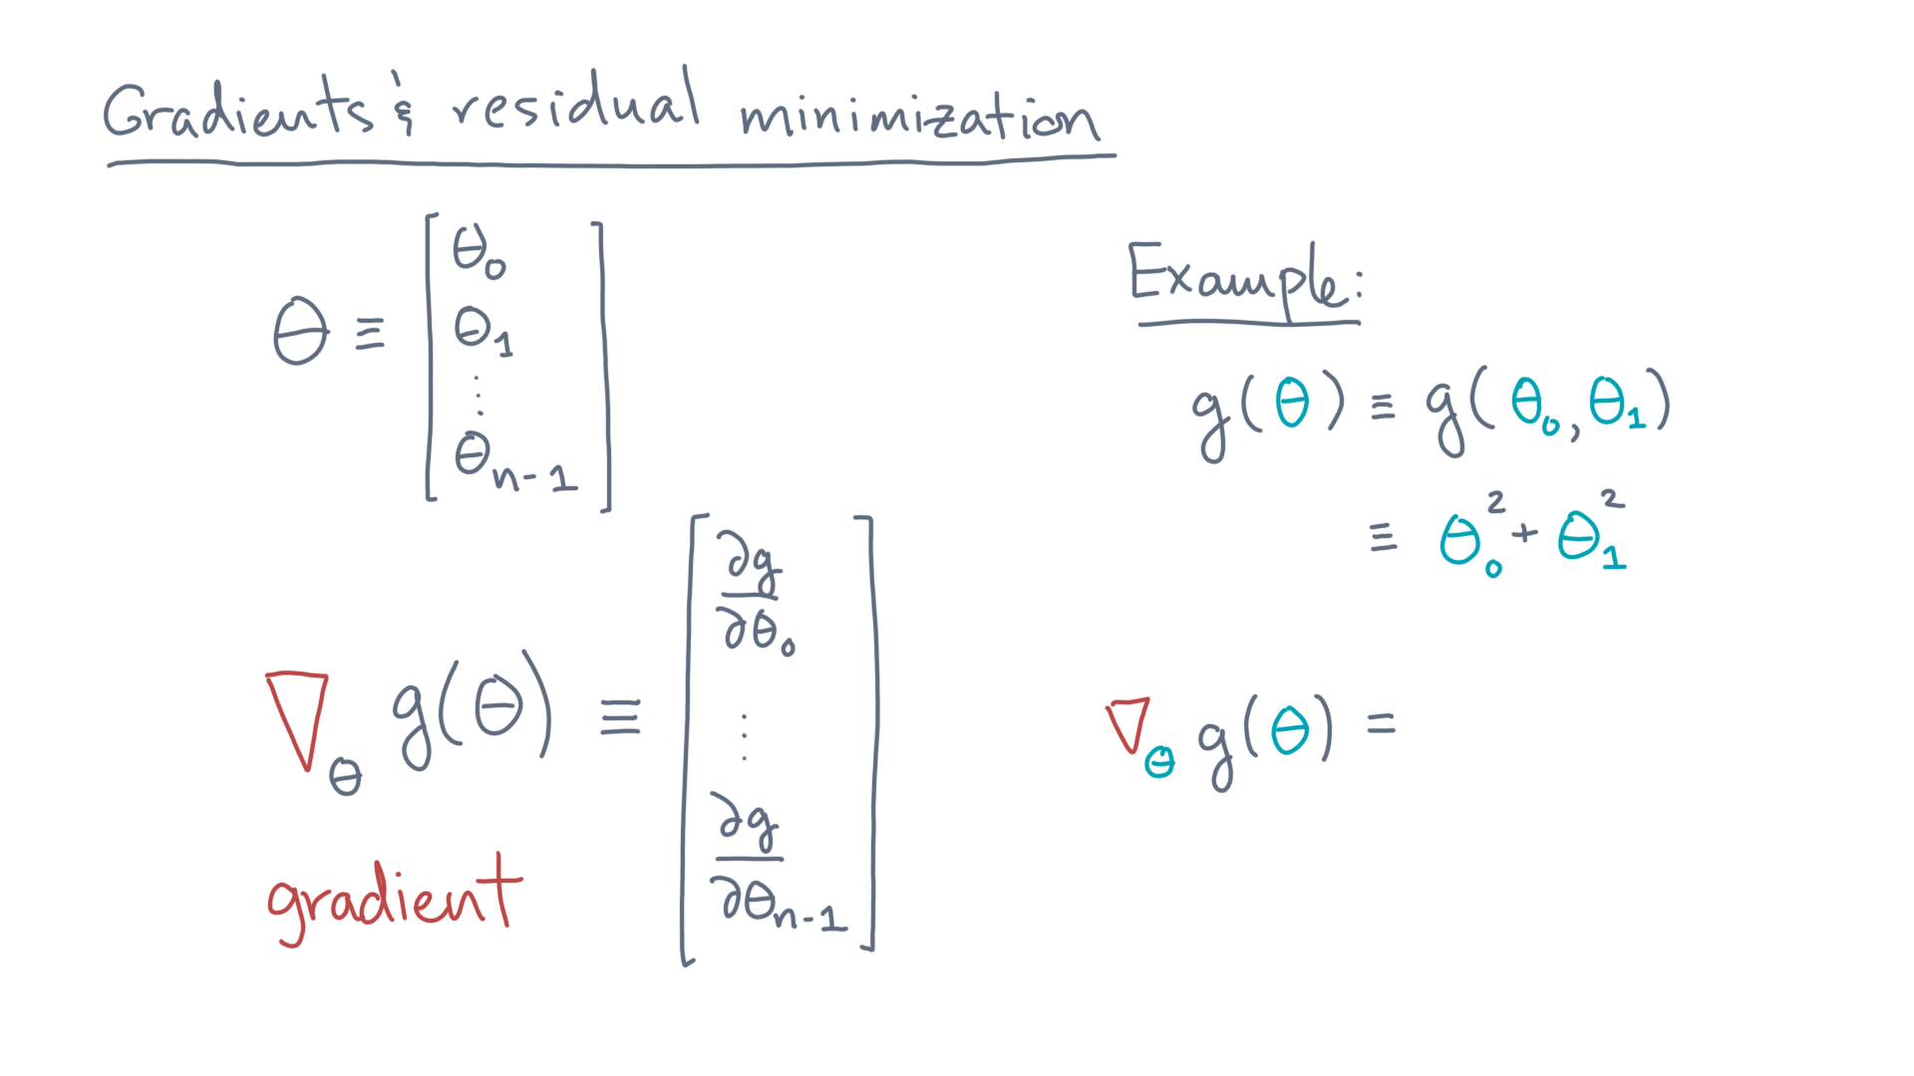
Notes:
So what is the gradient?

Slide 17
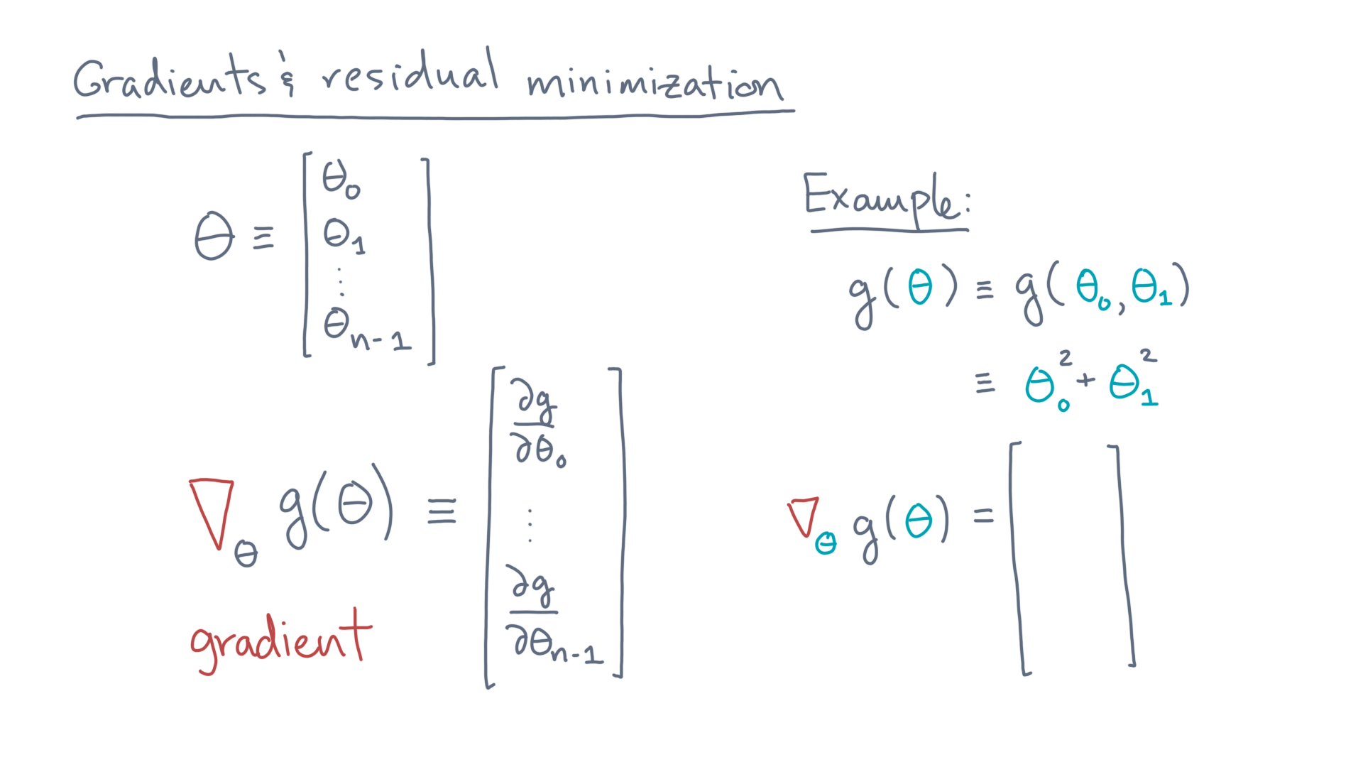
Notes:
It’s a vector of length two.

Slide 18
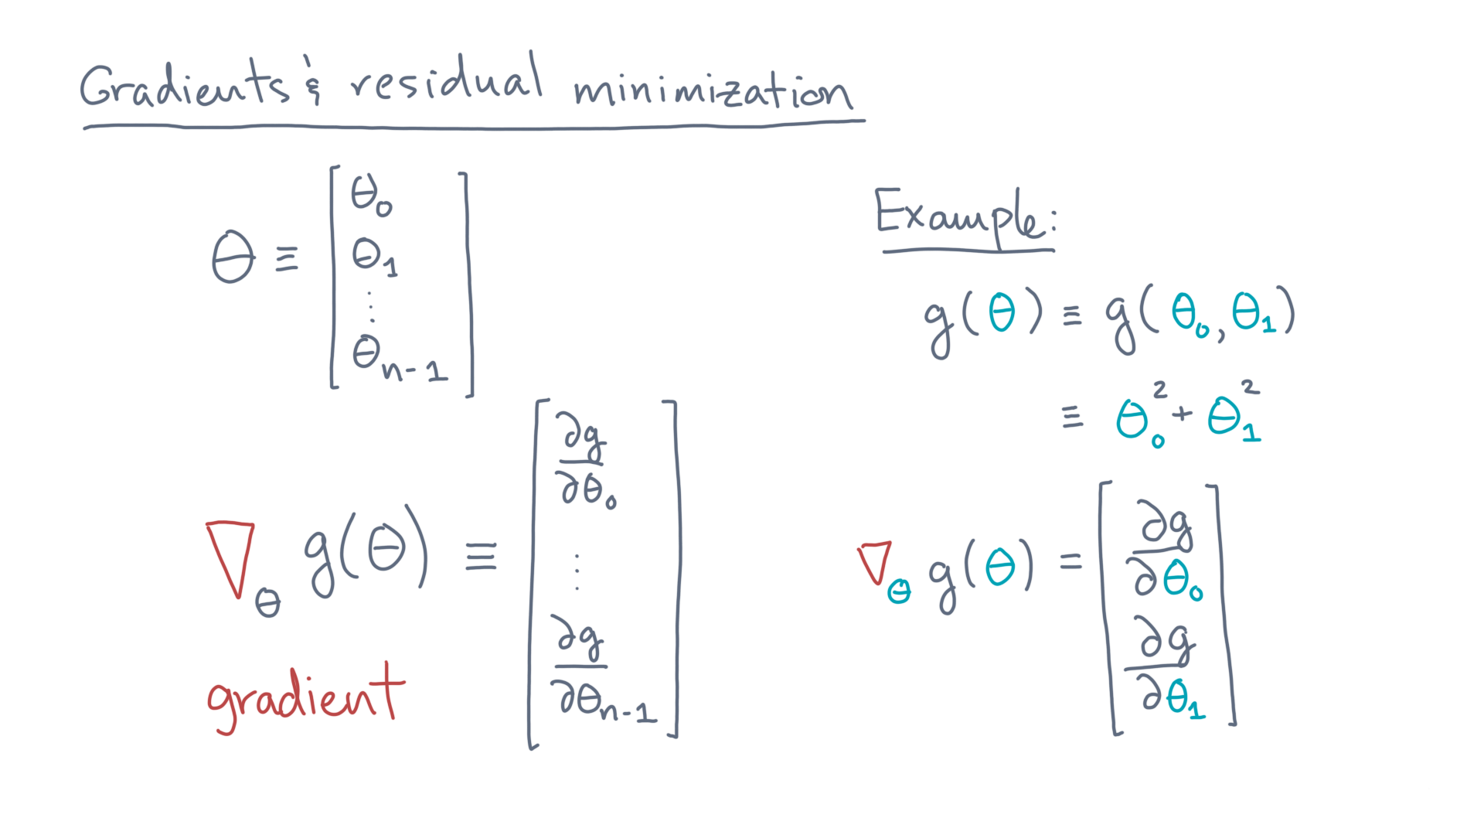
Notes:
Its two components are the partial derivatives of gee with respect to theta-zero and theta-one, respectively.

Slide 19
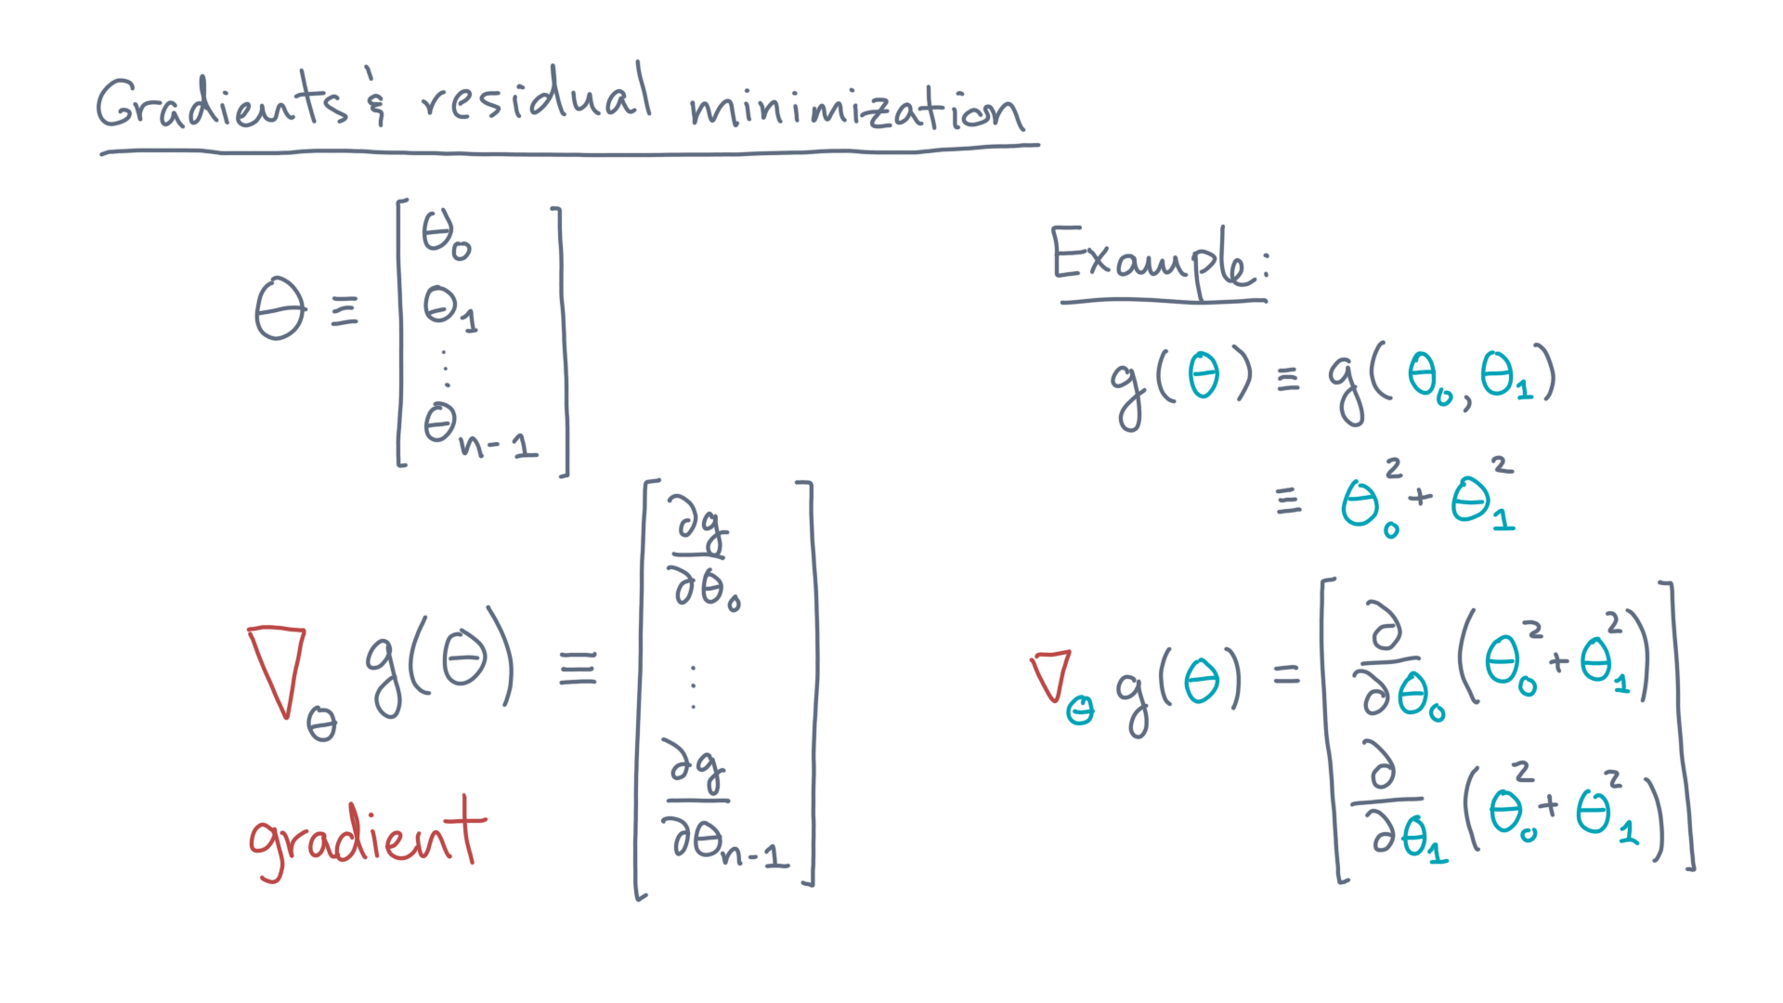
Notes:
Substitute gee.
Evaluate the derivatives.

Slide 20

Notes:
That yields two-times-theta-zero as the first component, and two-times-theta-one as the second.

Slide 21
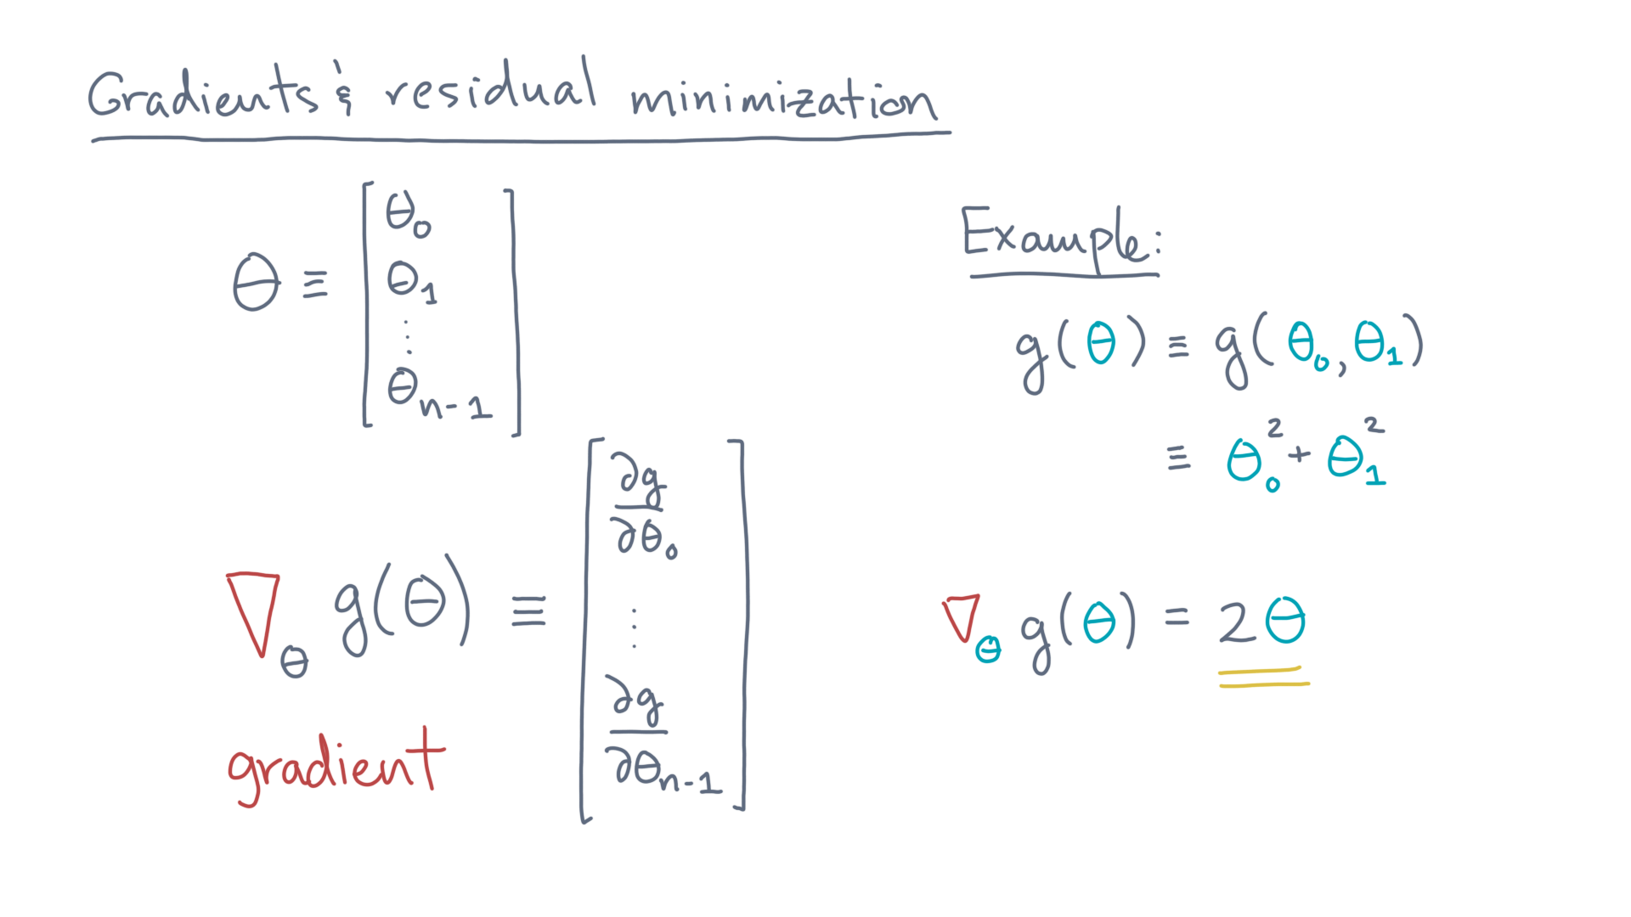
Notes:
Simplifying, that’s just two-times-theta.

Slide 22
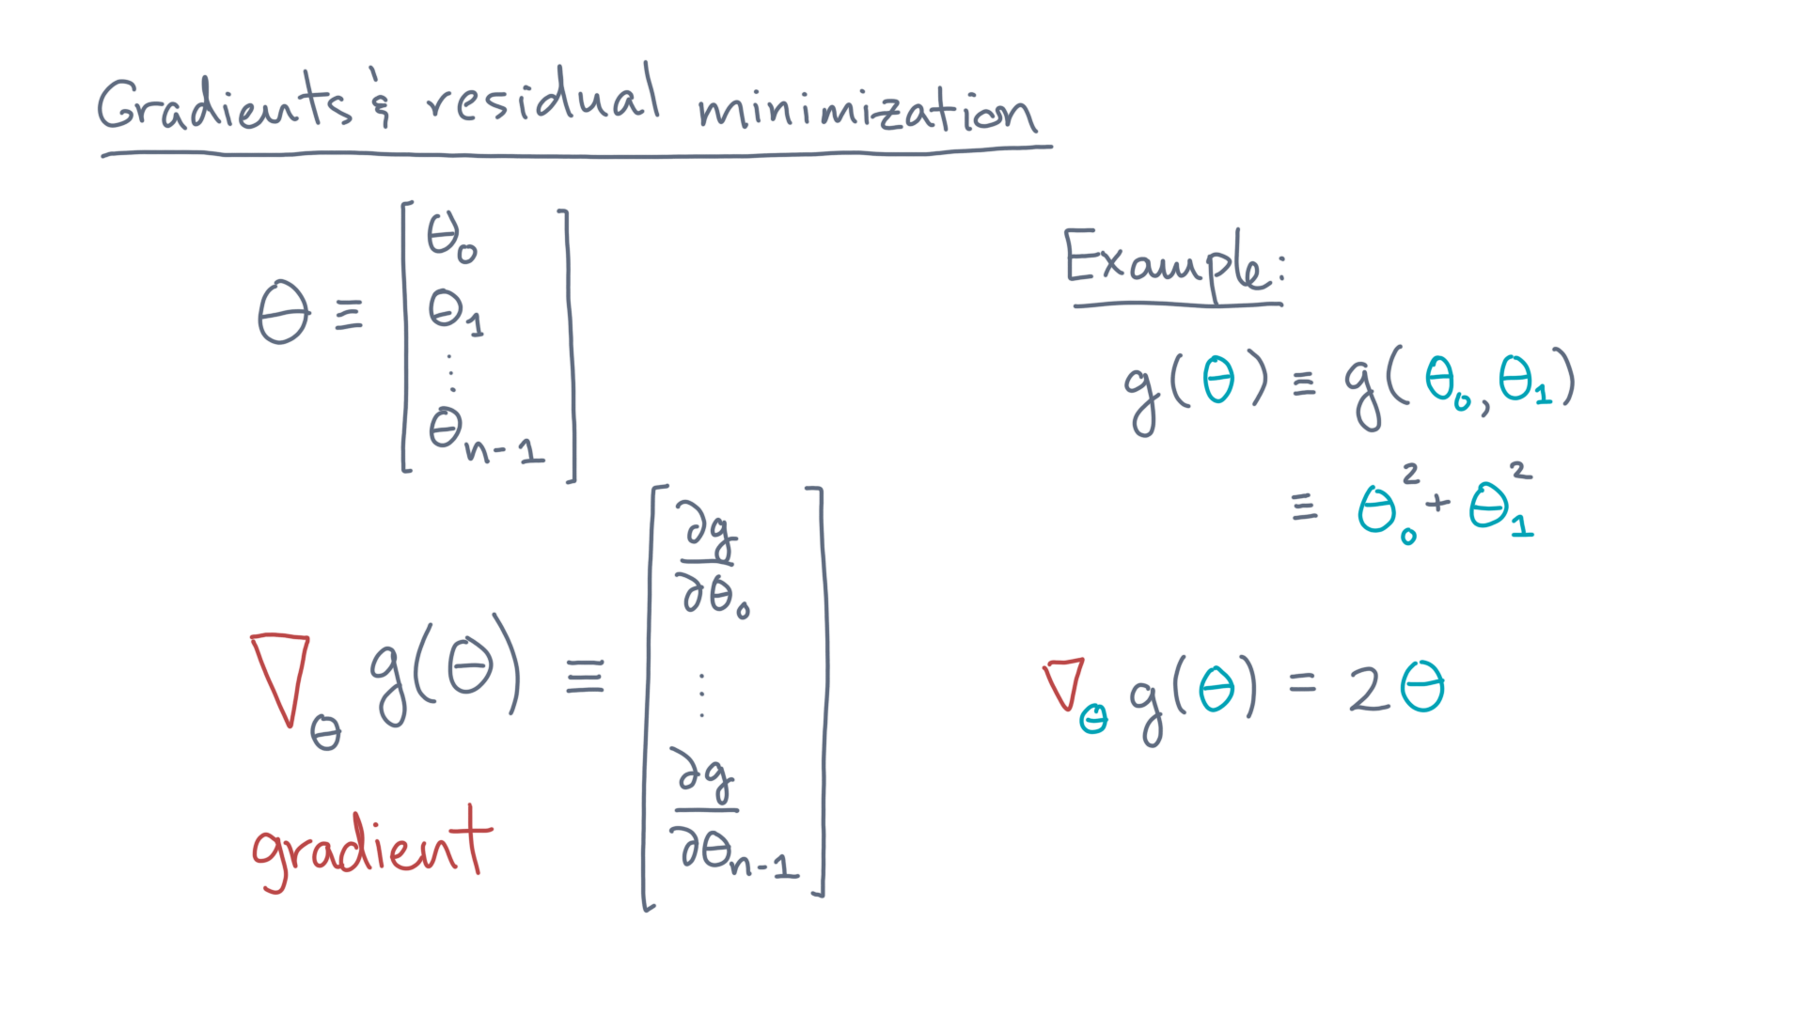
Notes:
Now that’s very abstract, so let’s look at this example, visually, with the help of a Jupyter notebook.

Slide 23
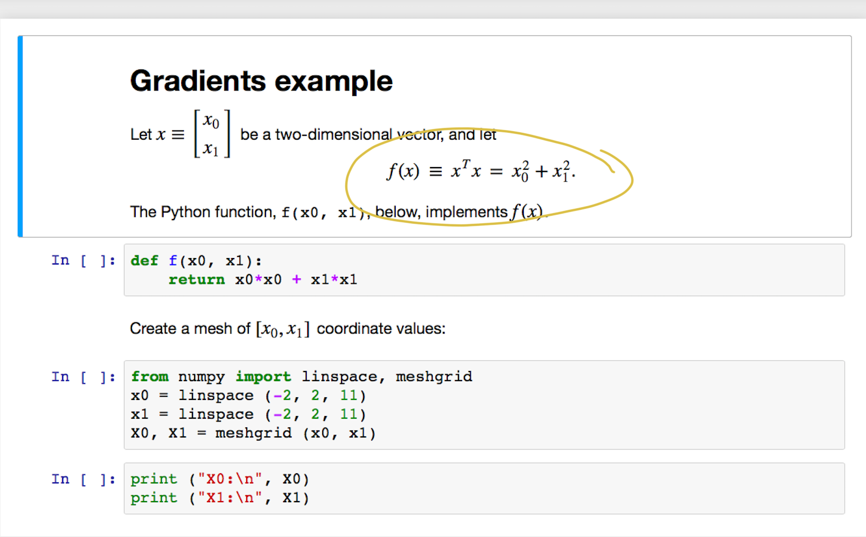
Notes:
Let’s start with the same example, here using the variable “x” instead of “theta.”

Slide 24
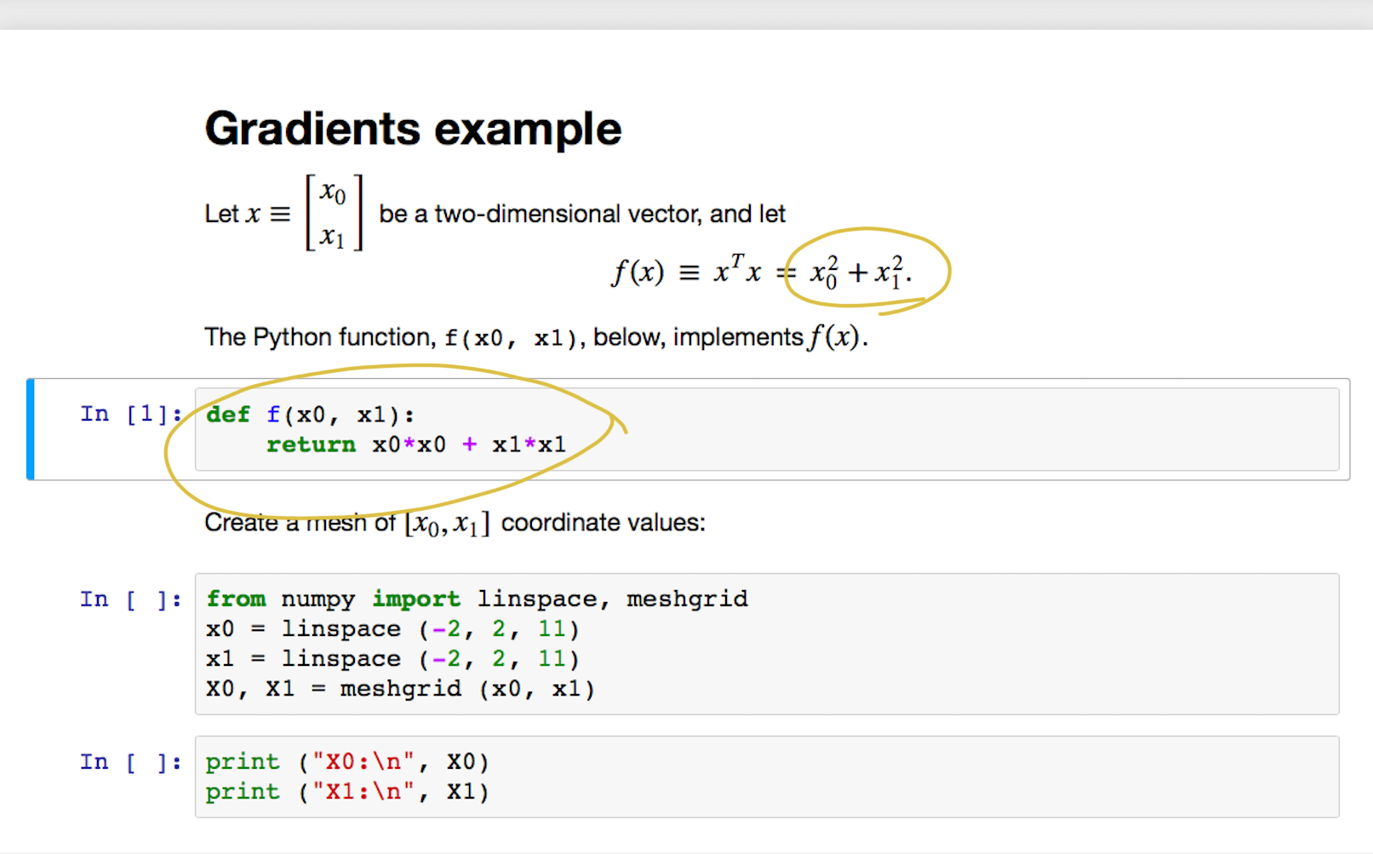
Notes:
The code just implements the formula.

Slide 25
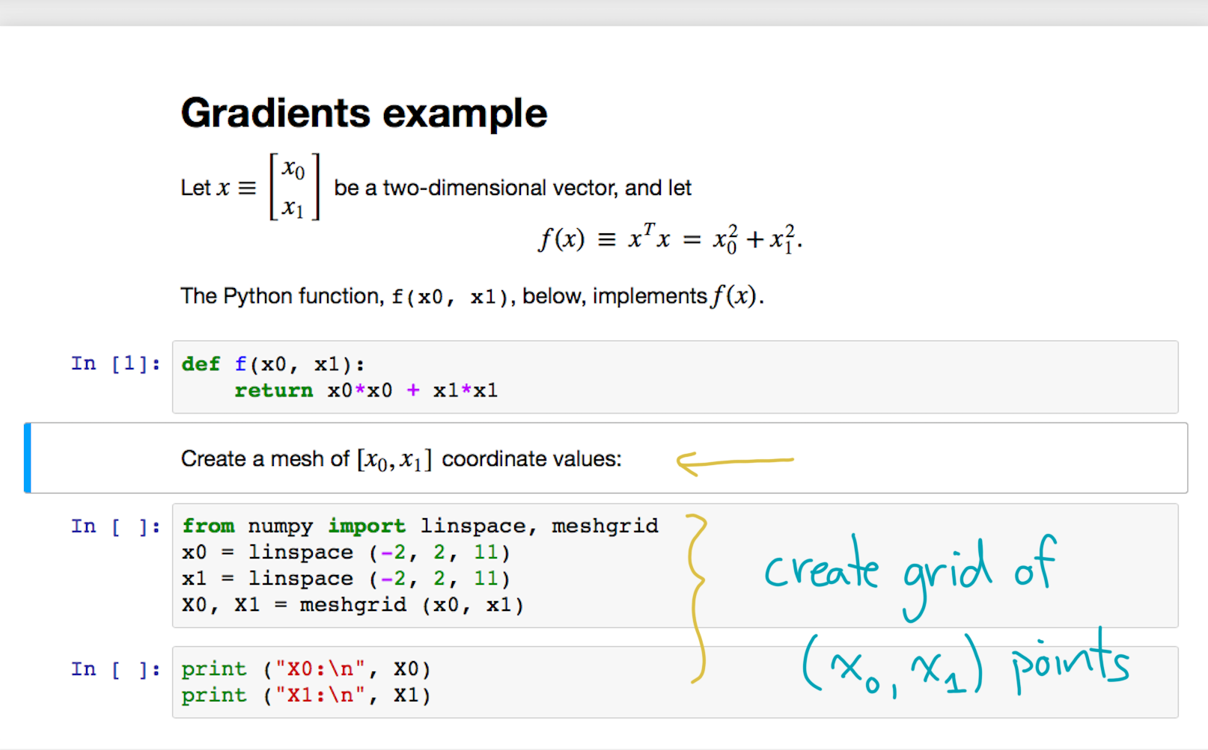
Notes:
Next, let’s create a grid of (x-zero, x-one) points.

Slide 26
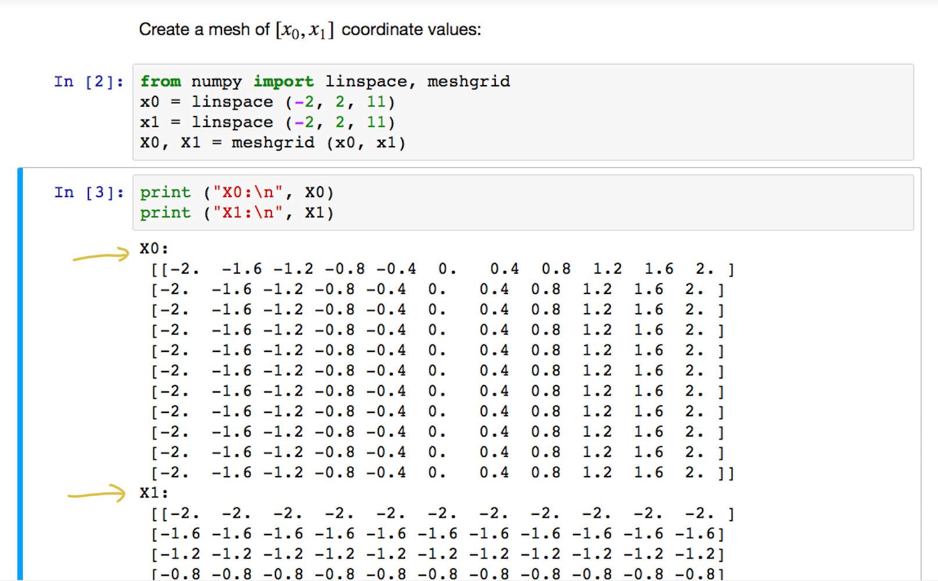
Notes:
Here is what the outputs might look like.
Notice that capital-X1 is the transpose of capital-X0.

Slide 27
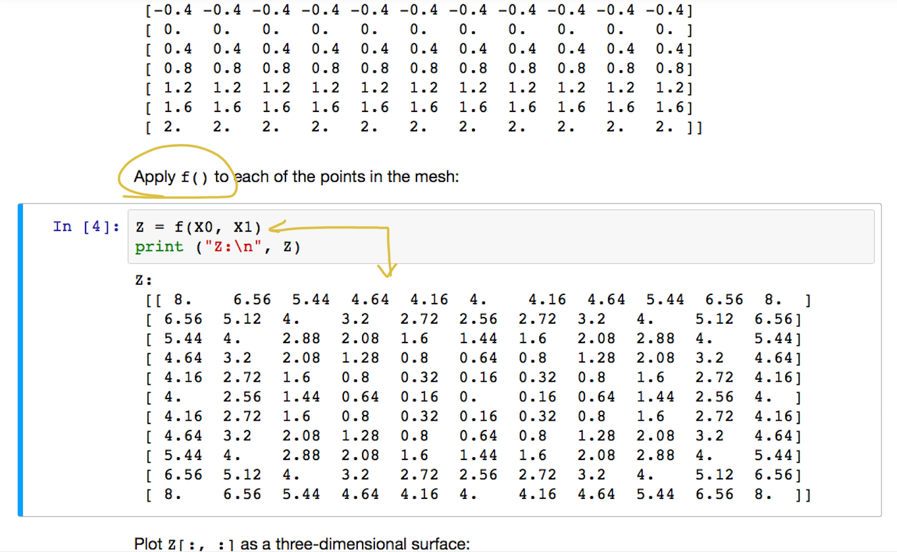
Notes:
Now let’s apply the function f to all the points on the grid.

Slide 28
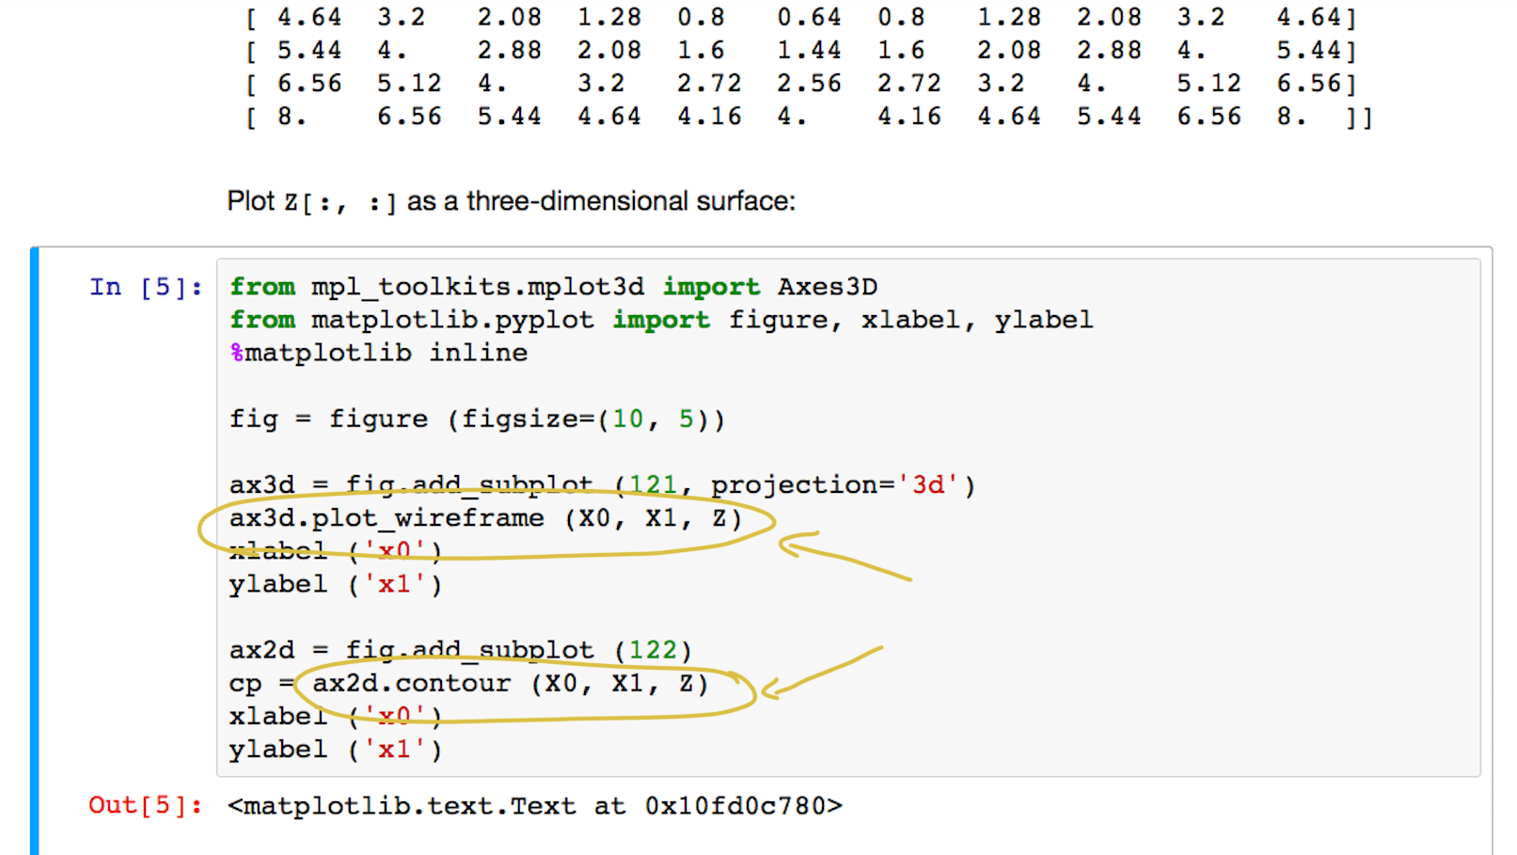
Notes:
And let’s draw the results in two ways:
First, as a three-dimensional surface, and secondly, as a two-dimensional contour plot.

Slide 29
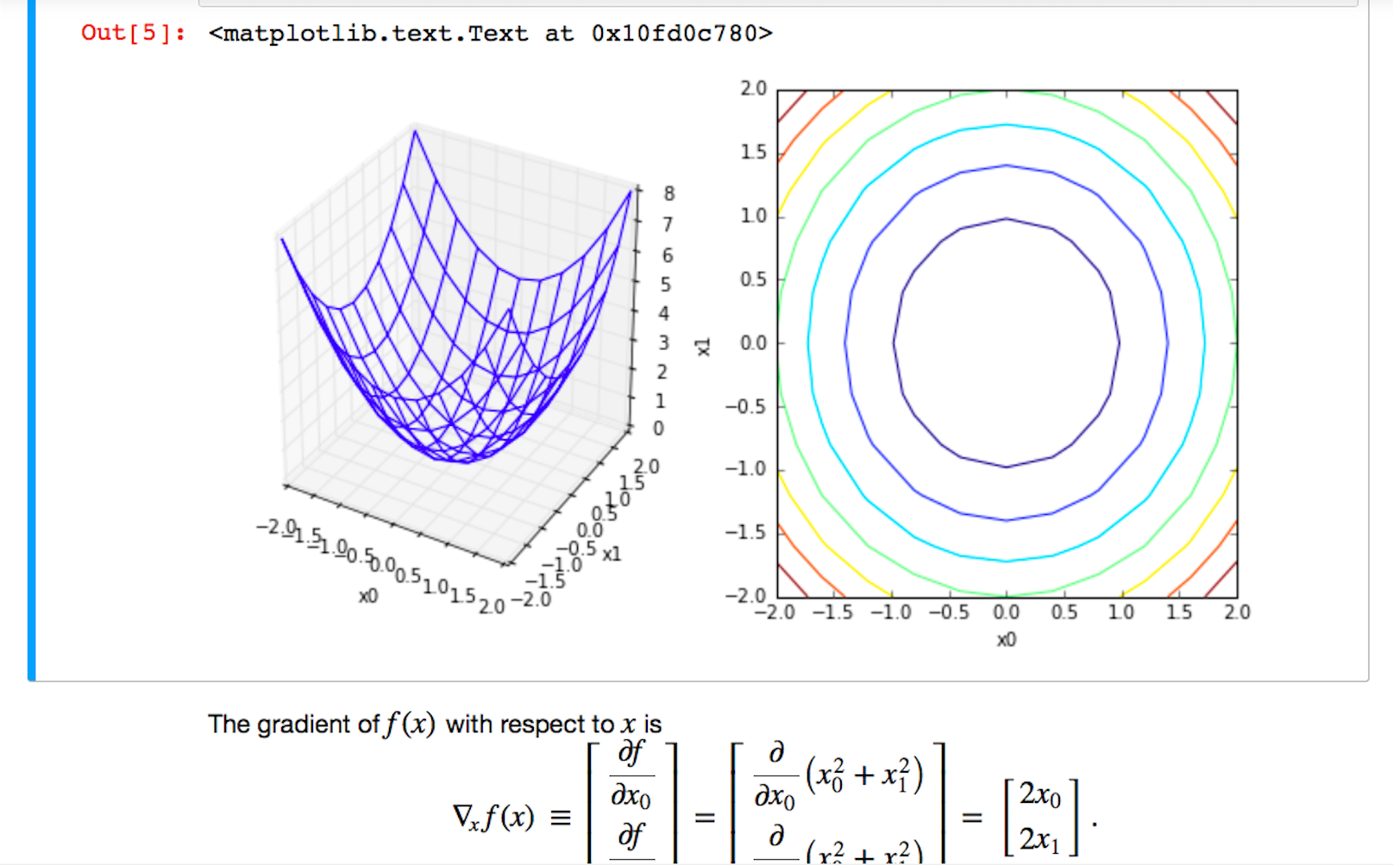
Notes:
Since we are squaring each component, we basically get a paraboloid, the multidimensional analogue of a parabola.
The left shows it in 3-D, and the right shows the same thing, but as a flat contour plot whose minimum value lies at the center.

Slide 30
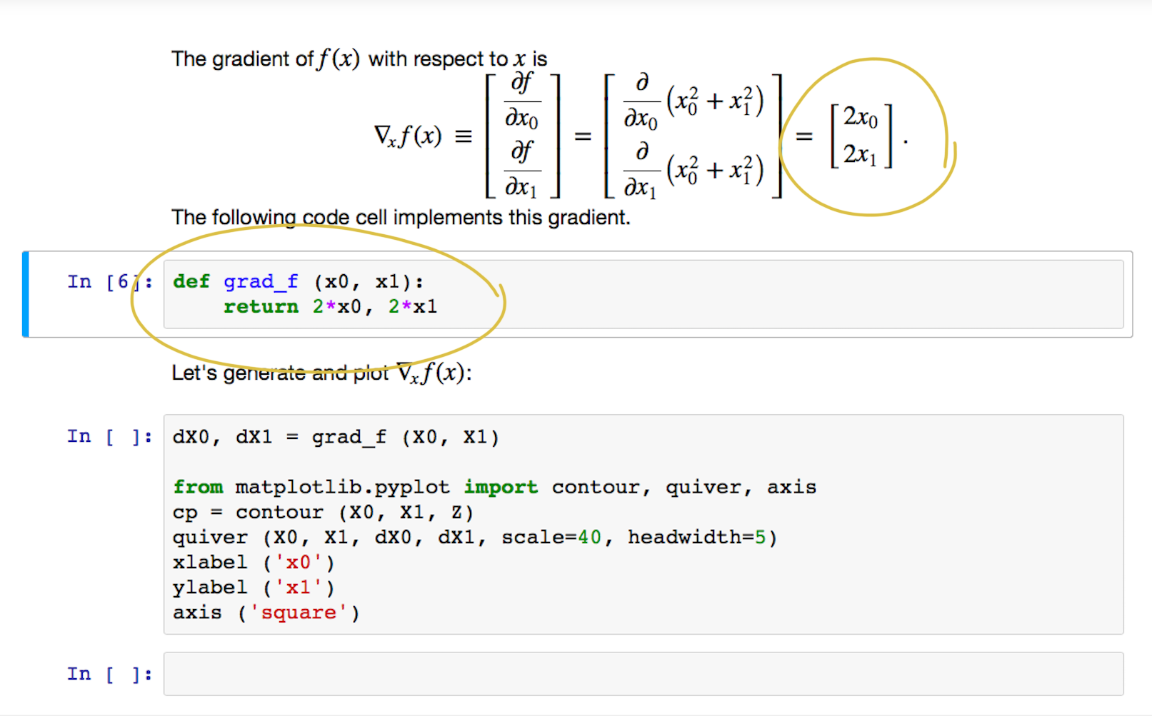
Notes:
Next, recall the gradient calculation, which we can implement as a Python function.

Slide 31
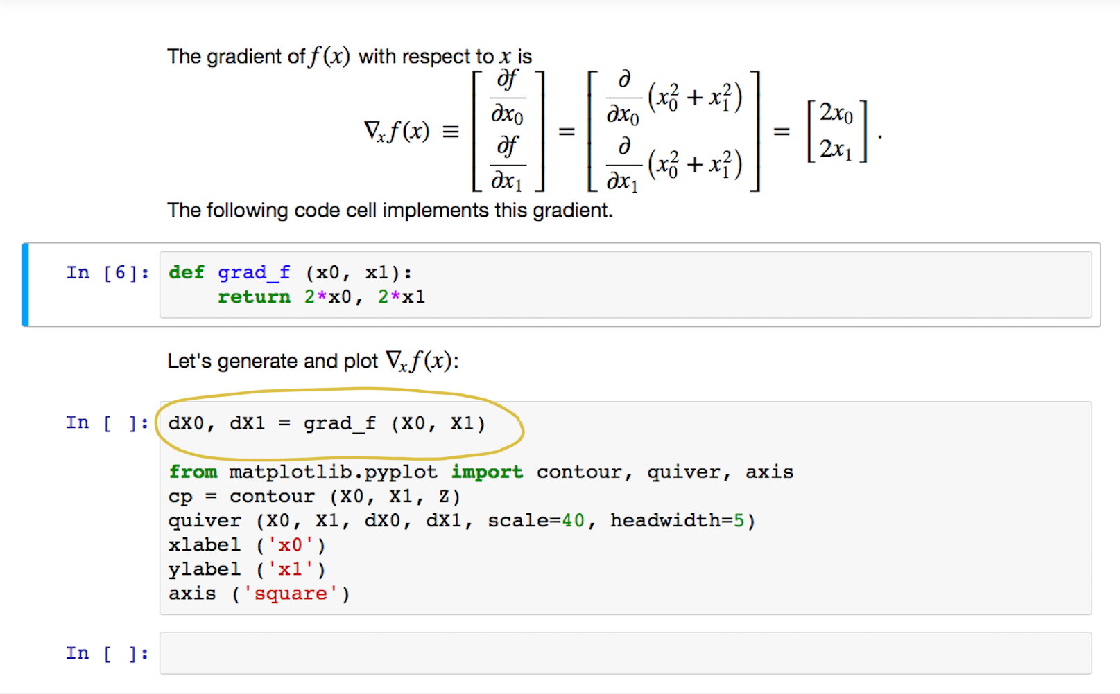
Notes:
When we evaluate it, we will get *vectors* at every point instead of scalars.

Slide 32
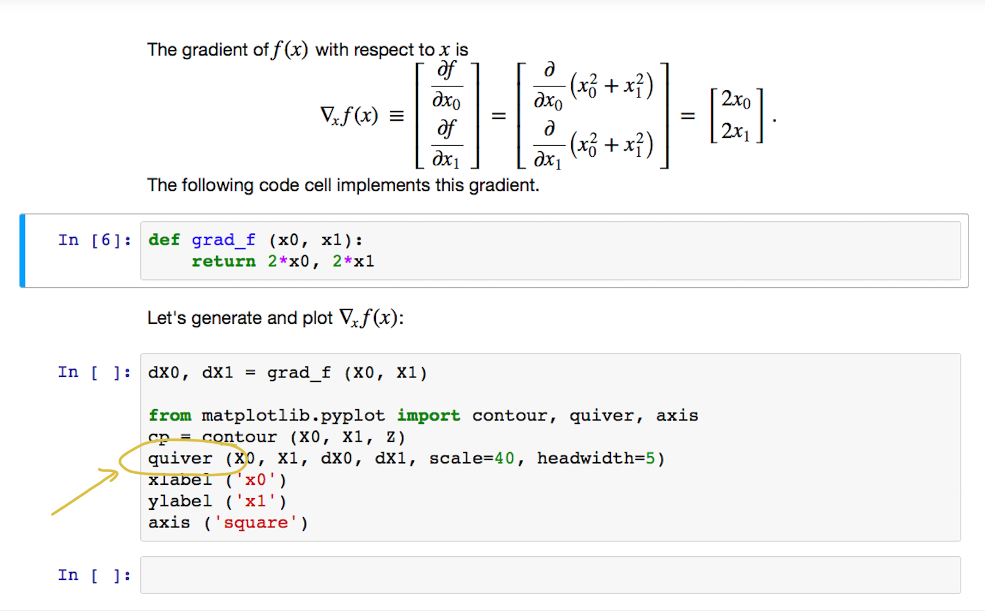
Notes:
Let’s add these to the contour plot as little arrows at every point.
The arrow will point in the direction of the gradient, and will be scaled proportionally to its magnitude.

Slide 33
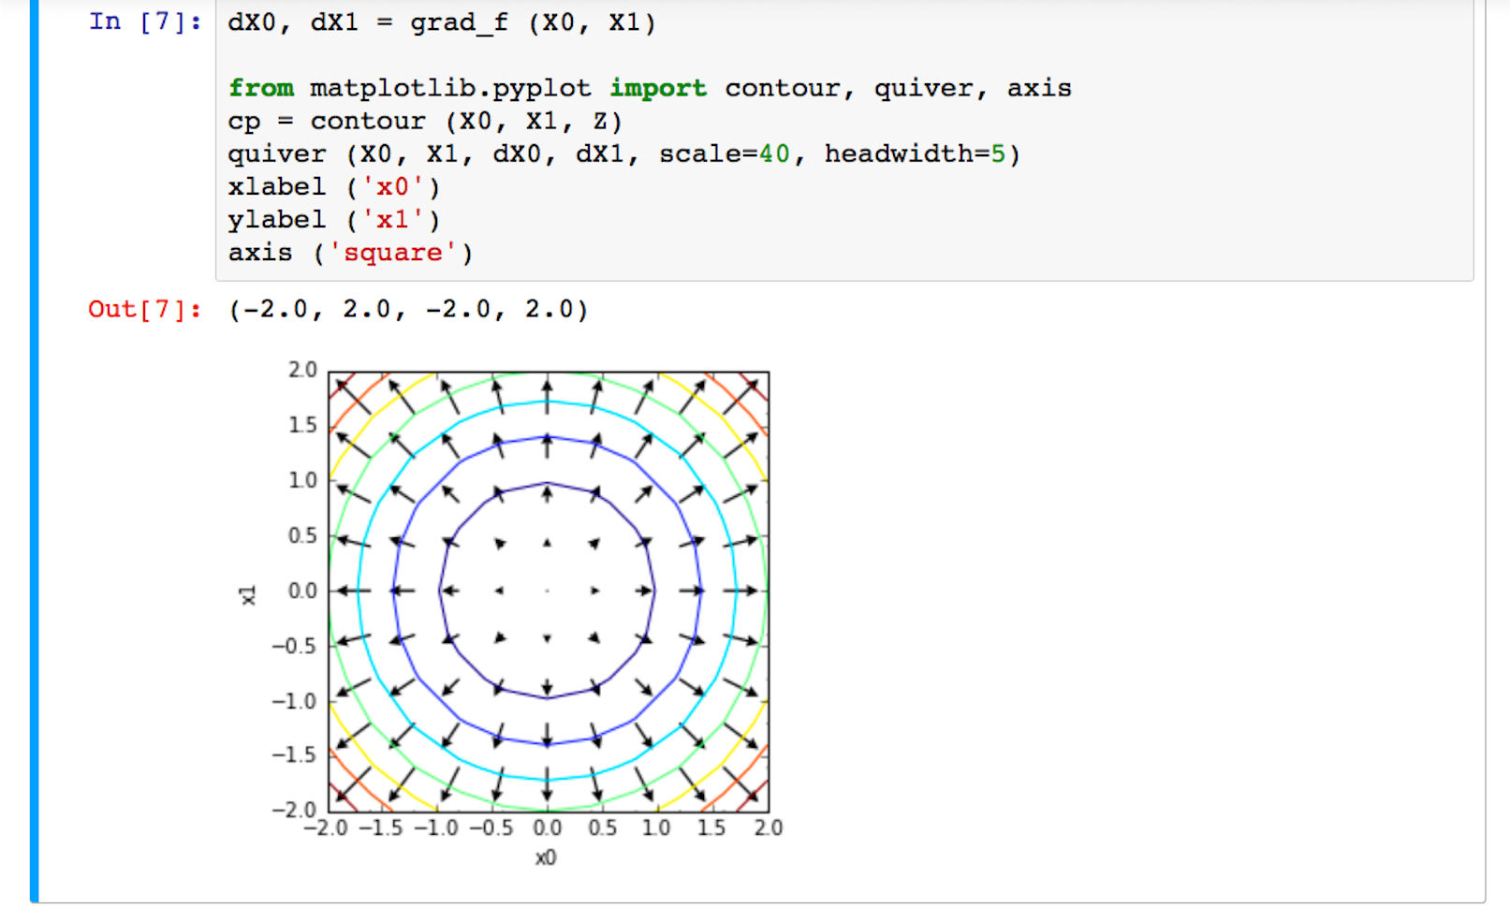
Notes:
Here is the result!

Slide 34
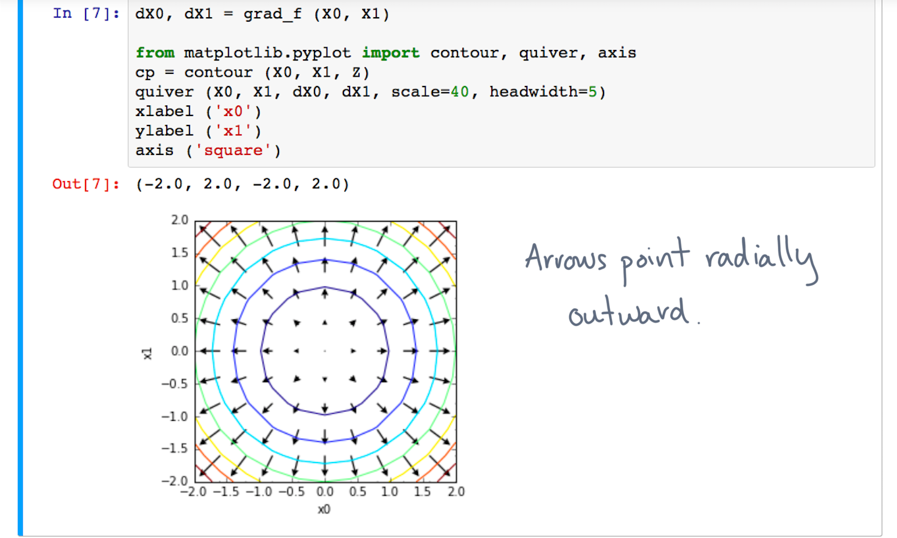
Notes:
Notice how the arrows point radially outward, away from the minimum value.

Slide 35
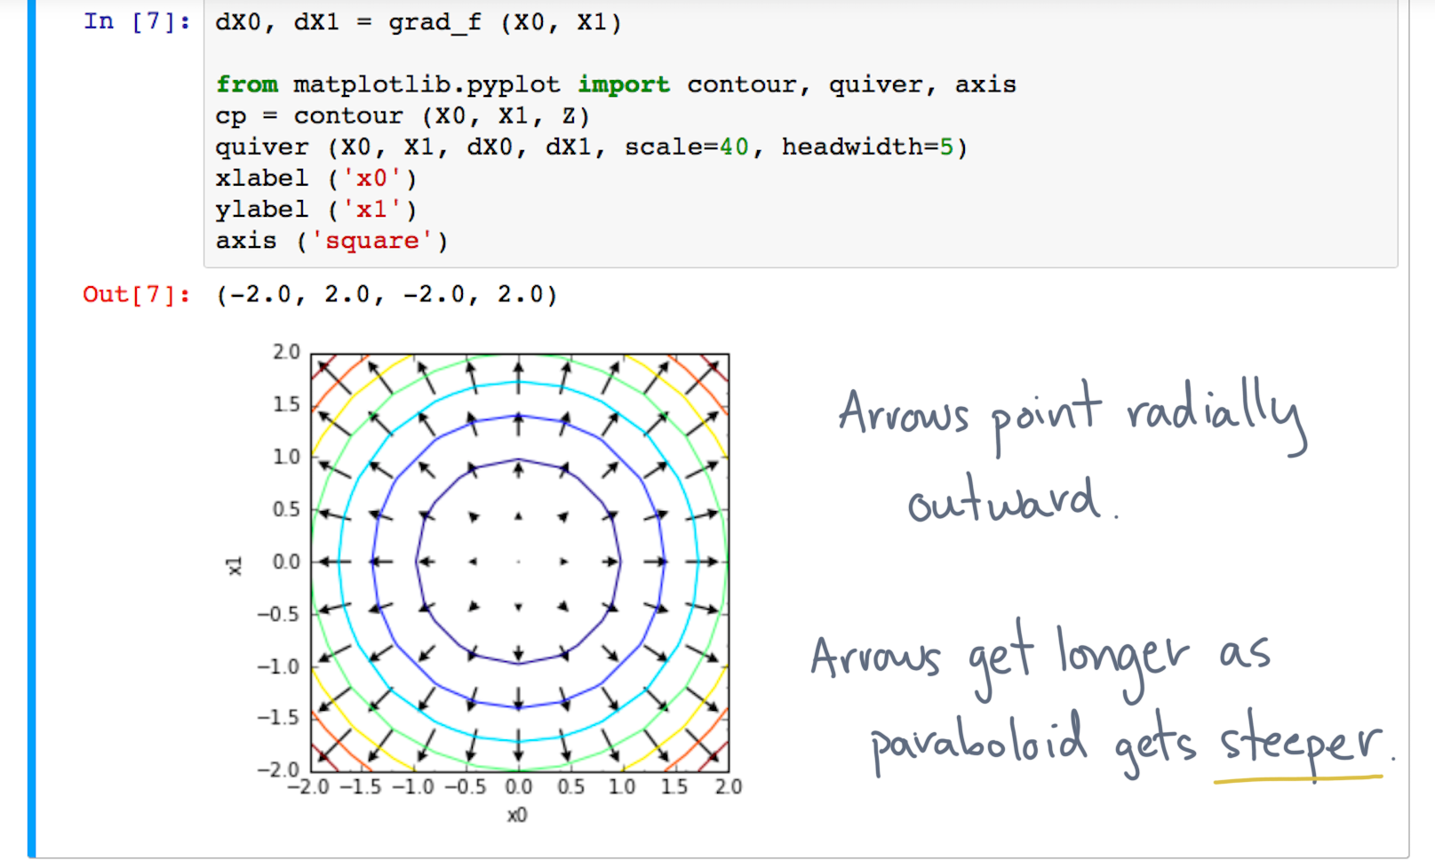
Notes:
They also increase in length as the paraboloid gets steeper.
I hope this picture builds your intuition for what the gradient does.

Slide 36
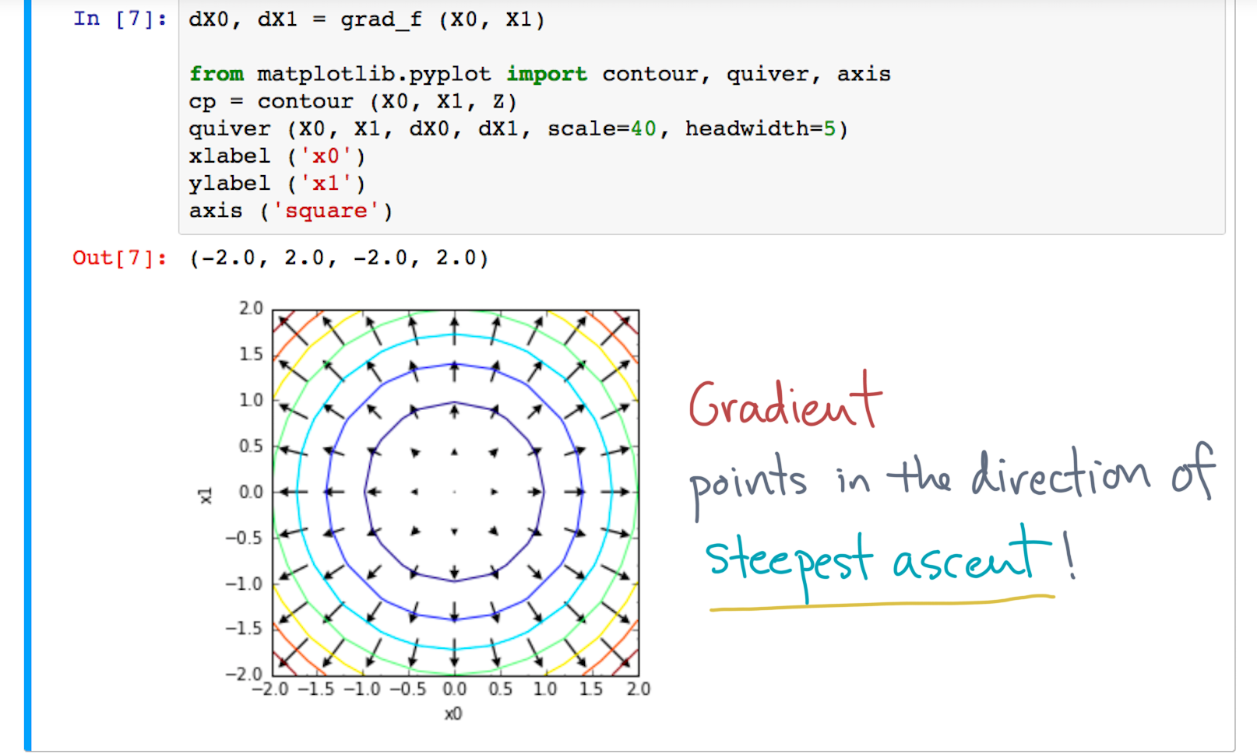
Notes:
Namely, it points in the direction of *steepest ascent*.
But that’s not all! (Do I sound like a salesperson yet?)

Slide 37
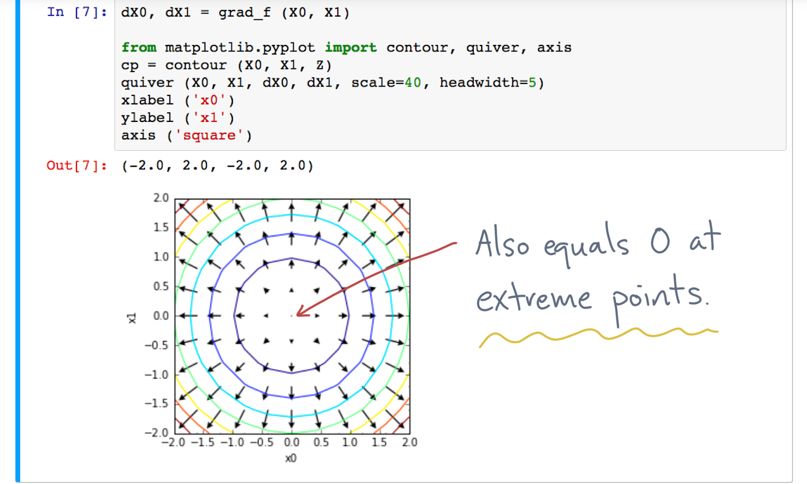
Notes:
The gradient is also zero at extreme points.
That’s similar to what happens to the one-dimensional derivative.

Slide 38
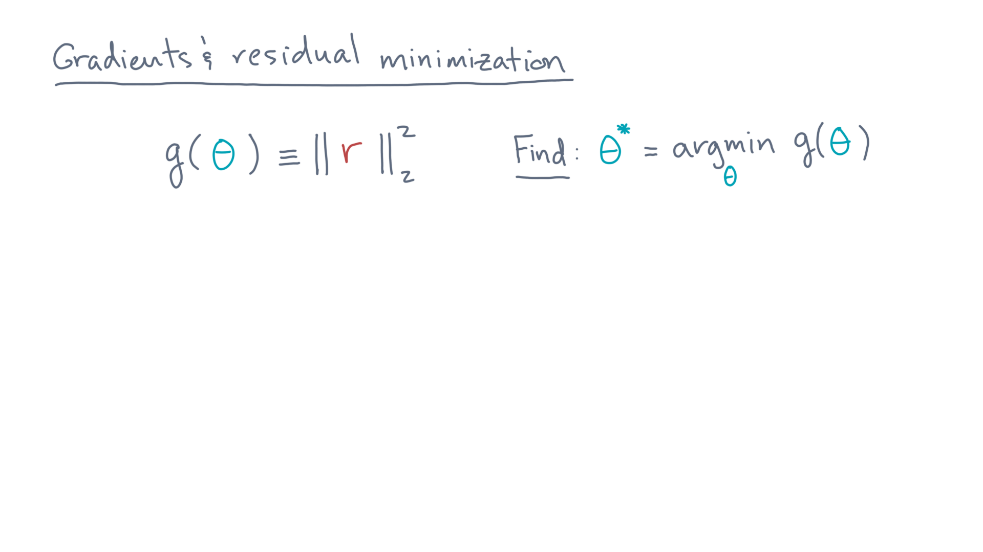
Notes:
You now have all the building blocks you need to solve the multiple regression problem.
Recall that that’s to find the theta that minimizes the squared two-norm of the residual.

Slide 39
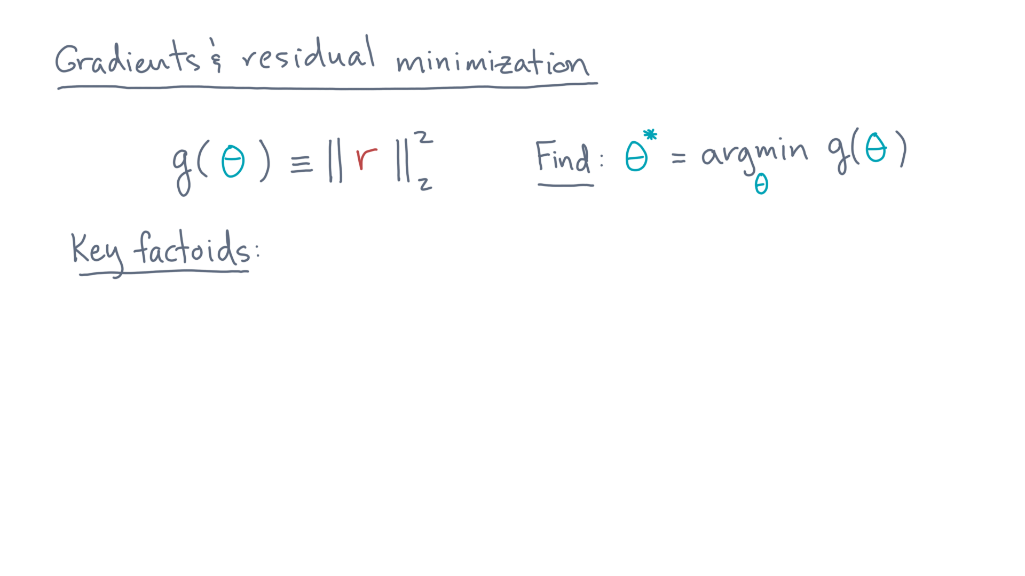
Notes:
Rather than show you in detail, let me give you the facts you need.
As an exercise, you should derive these facts and apply them to obtain the final result, which I am about to show you.

Slide 40
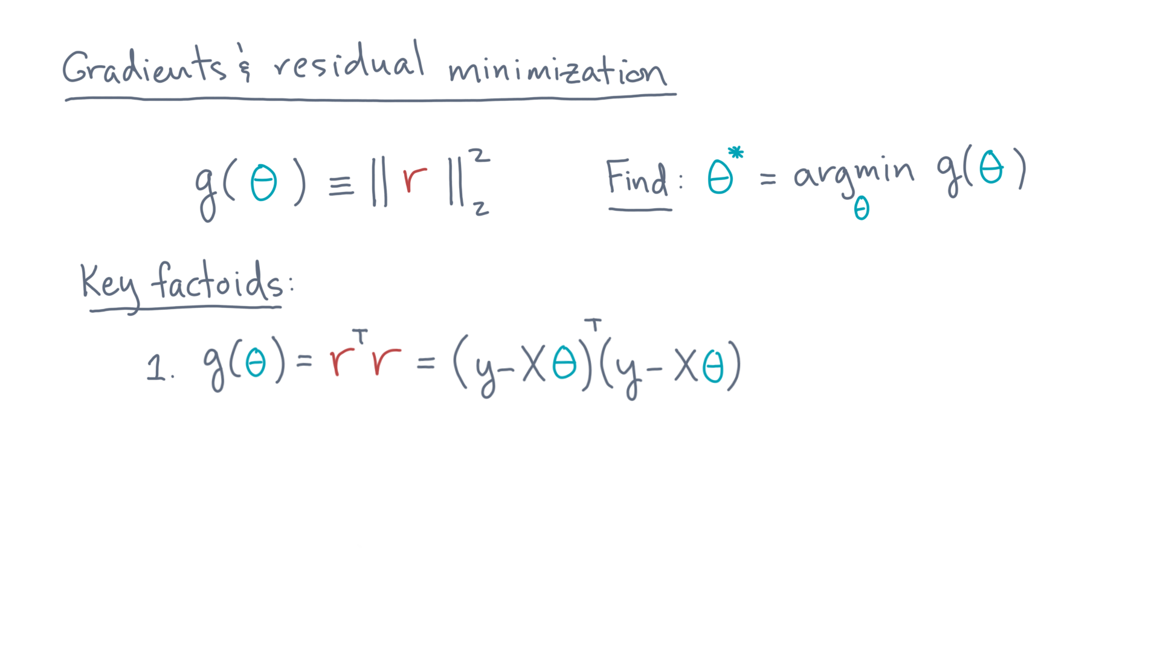
Notes:
The first is just the definition of gee-of-theta.

Slide 41
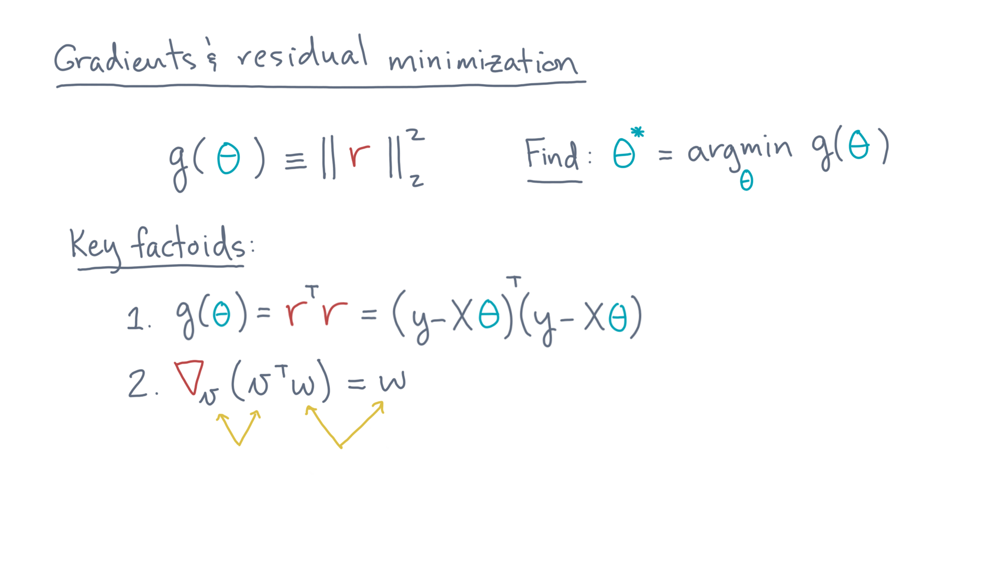
Notes:
Here is the second:
Suppose “vee” and “double-you” are two vectors.
Then the gradient of v-transpose-w with respect to v is w.

Slide 42
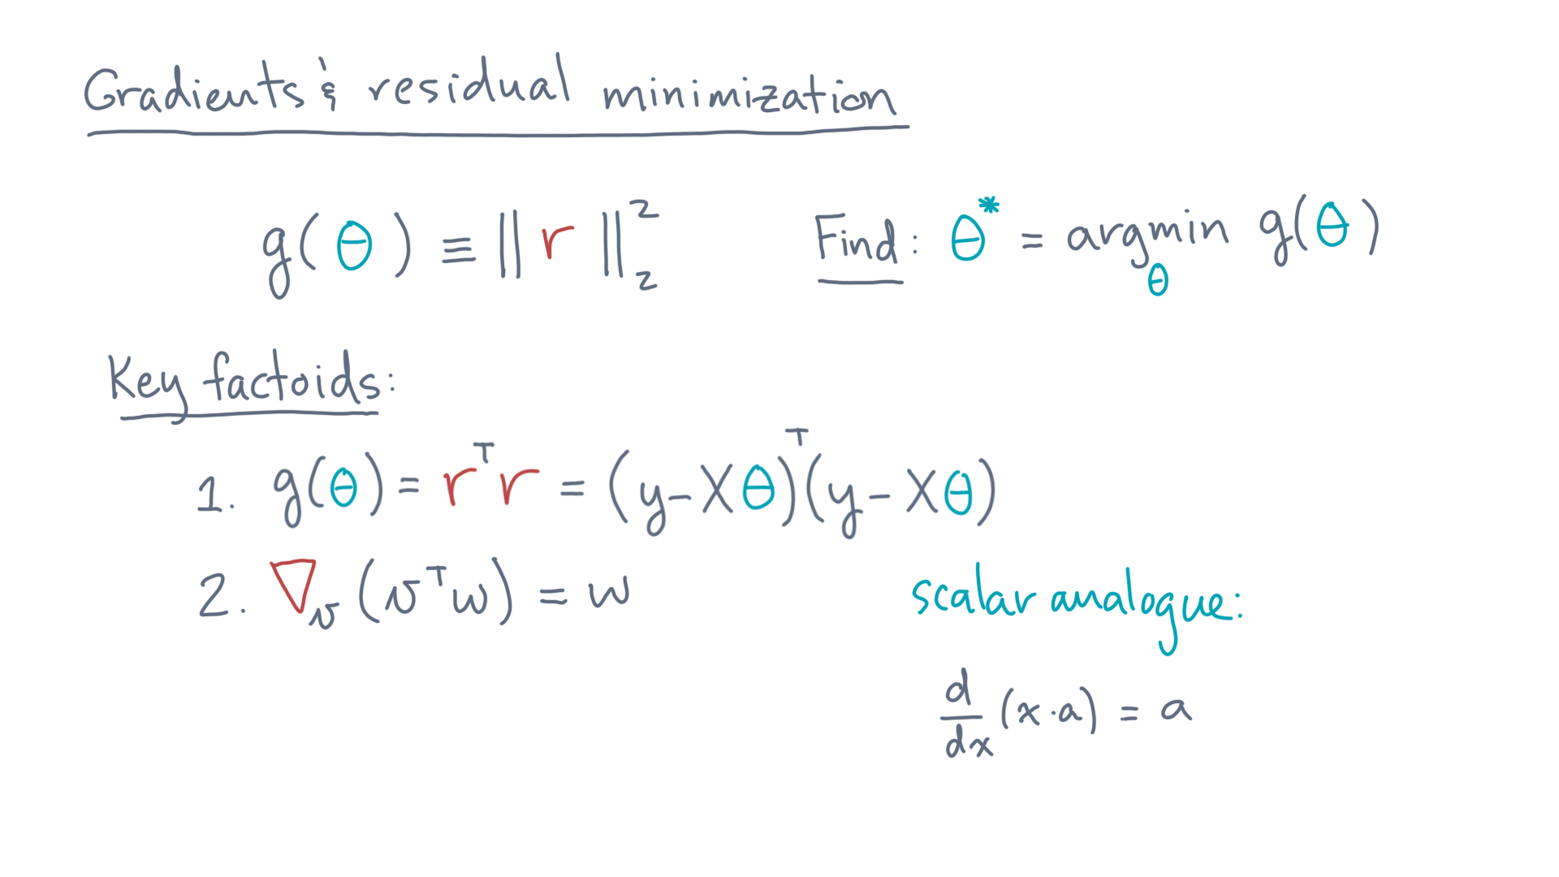
Notes:
An easy way to remember this one is to recall its scalar analogue:
The derivative of x times a with respect to x is just a.

Slide 43
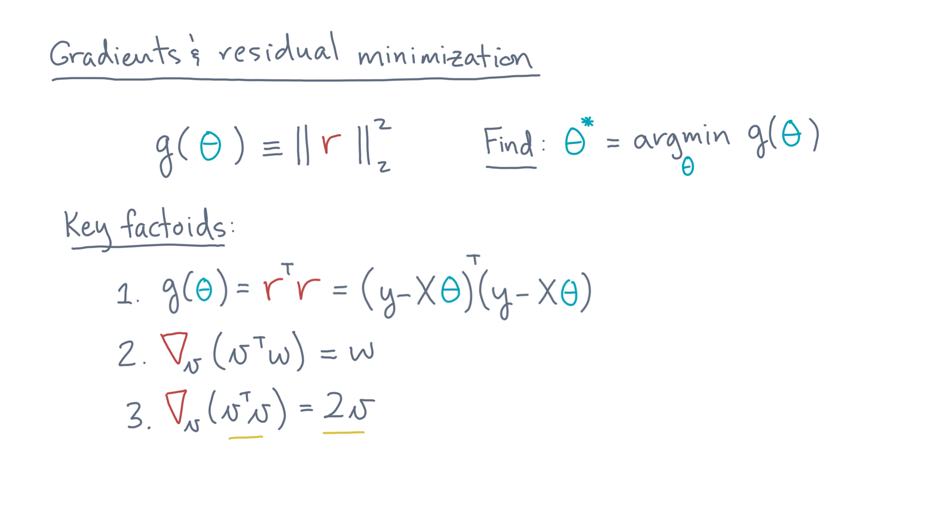
Notes:
Here is the third factoid: the gradient of v-transpose-v with respect to vee is 2 times vee.

Slide 44
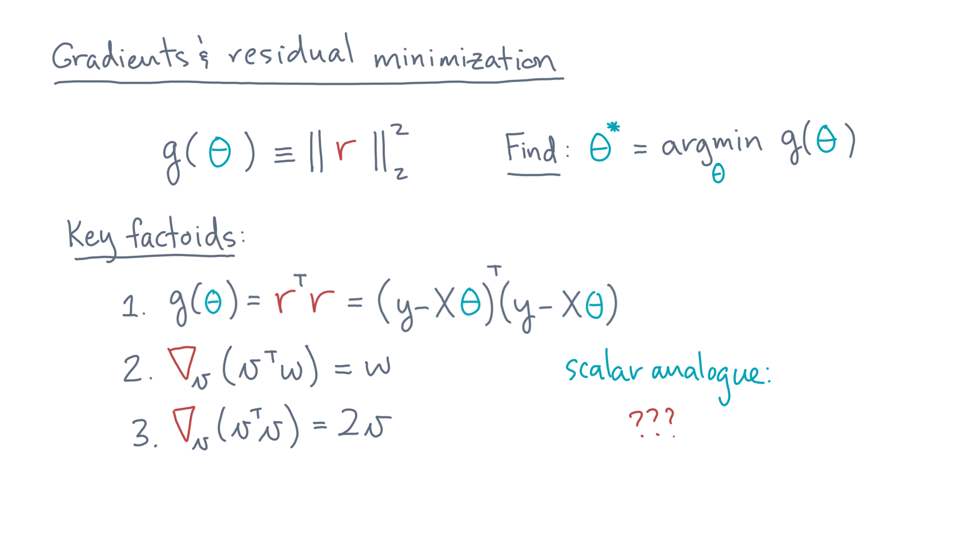
Notes:
Can you think of a scalar analogue to help you remember this one?

Slide 45
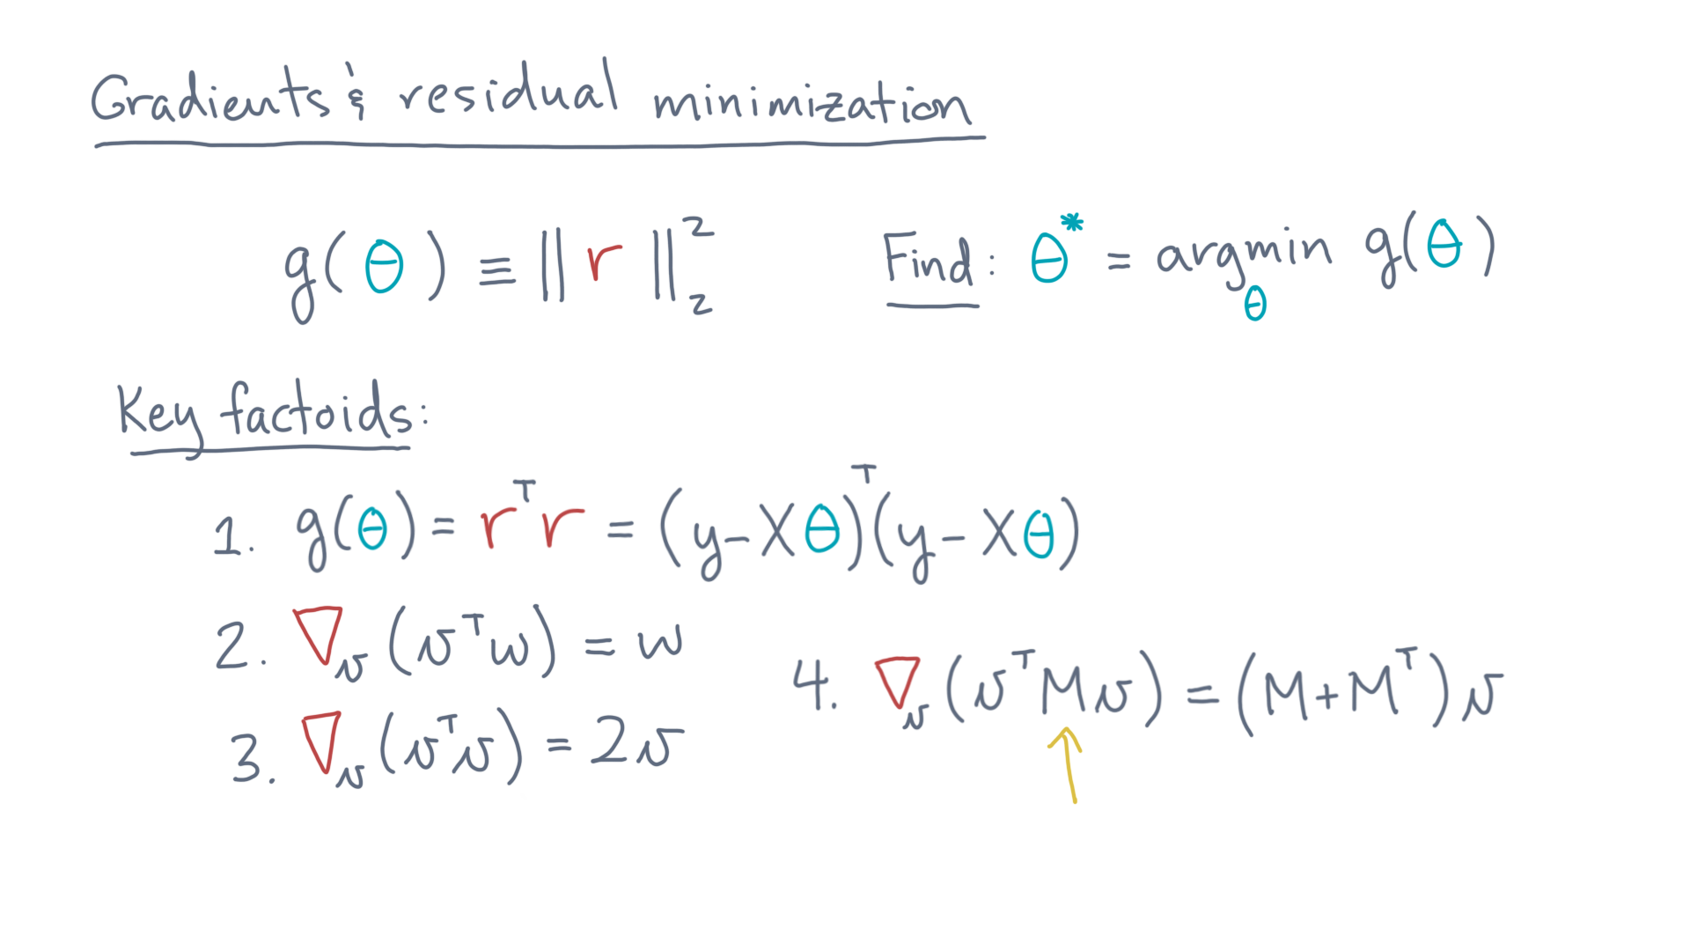
Notes:
Here is the fourth, and final, fact.
Suppose “capital-M” is a matrix.
Then the gradient of v-transpose-times-M-times-v equals (M plus M-transpose) times v.

Slide 46
Notes:
Armed with these facts, you can show the following.

Slide 47
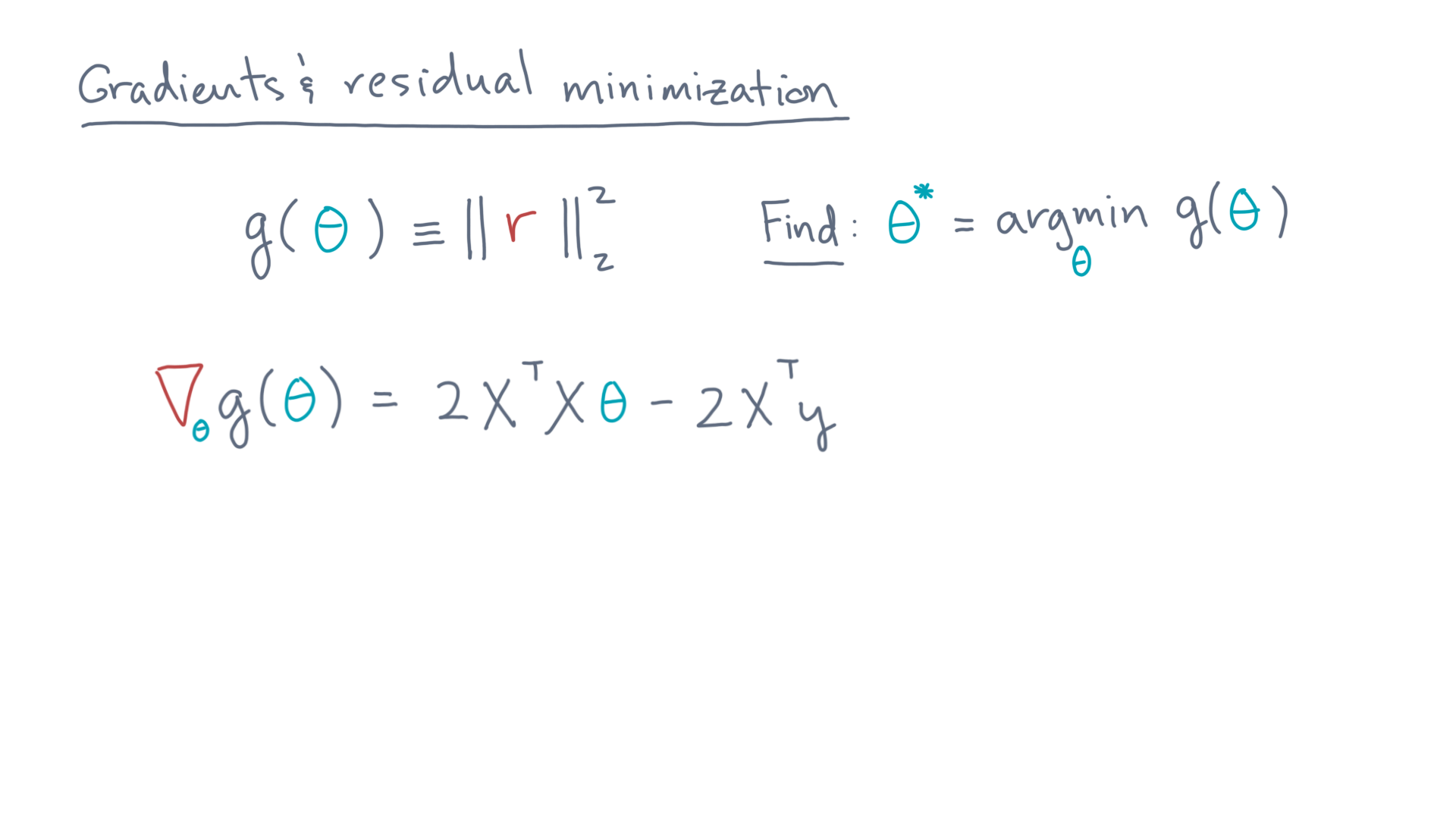
Notes:
First, the gradient of gee is 2 times X-transpose-X-theta minus 2 times X-transpose-y.

Slide 48
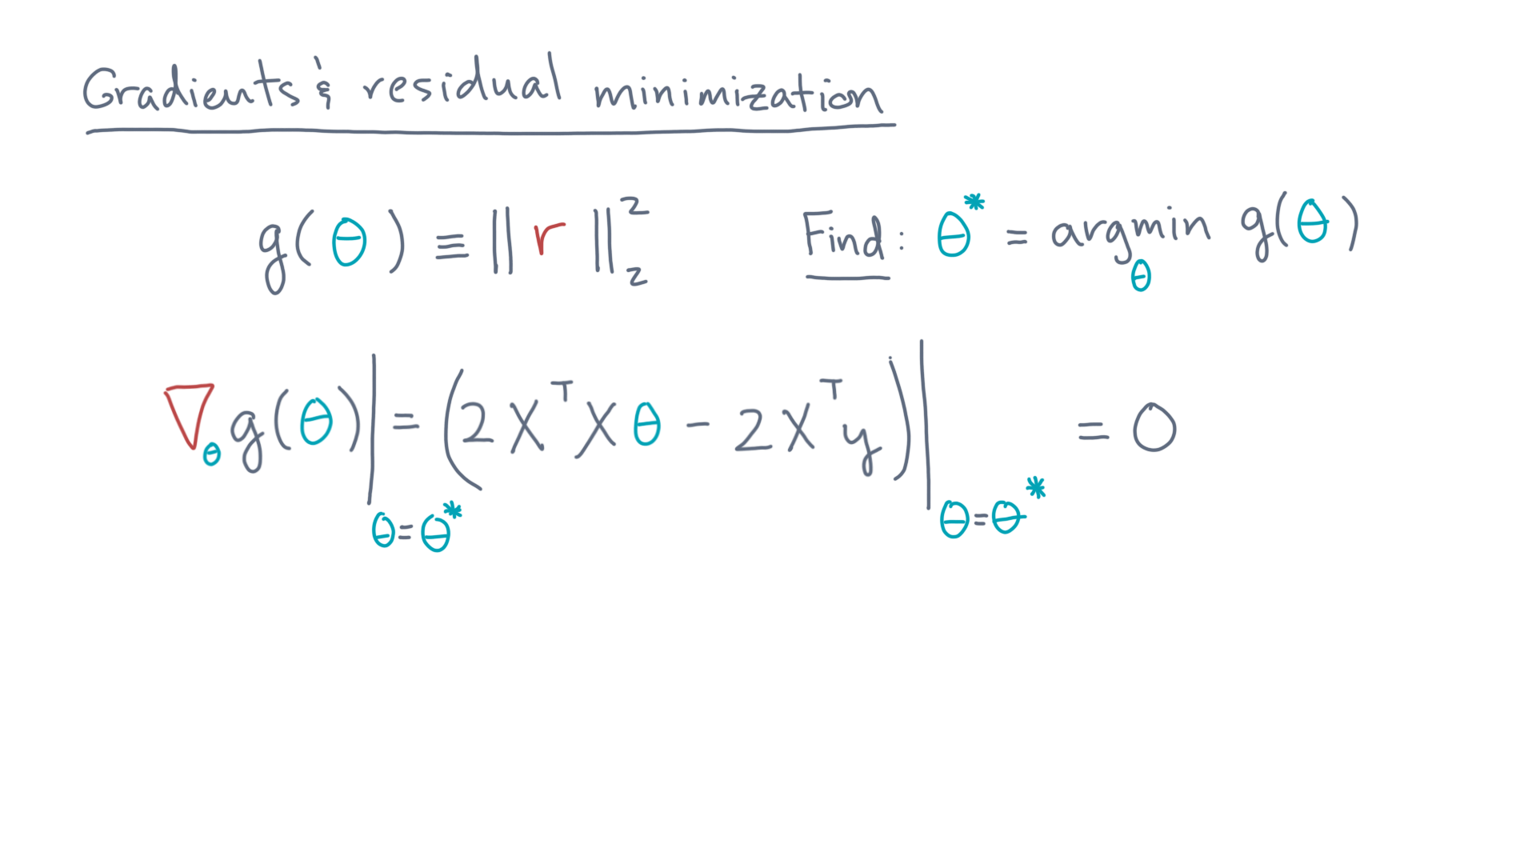
Notes:
You can then ask: what is the value of theta, call it theta-star, at which the gradient is zero?

Slide 49
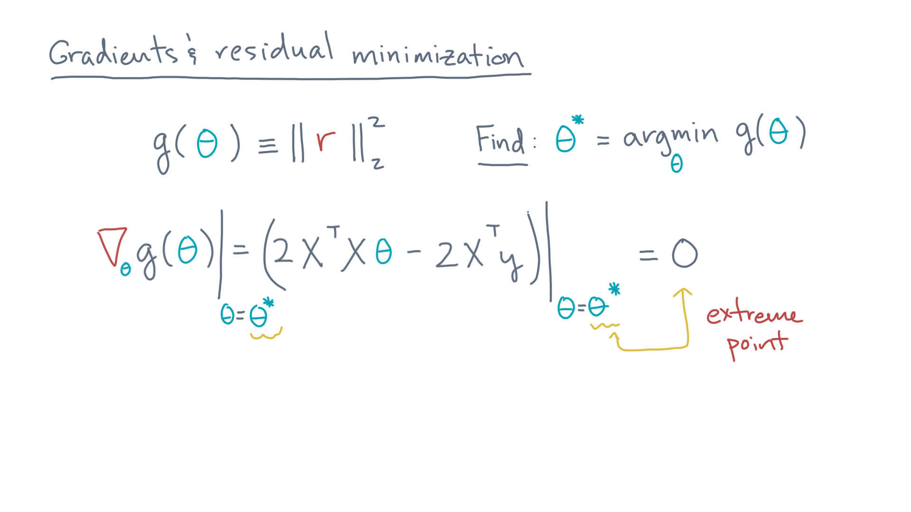
Notes:
After all, that would be an extreme point, and therefore a candidate for minimizing gee.

Slide 50
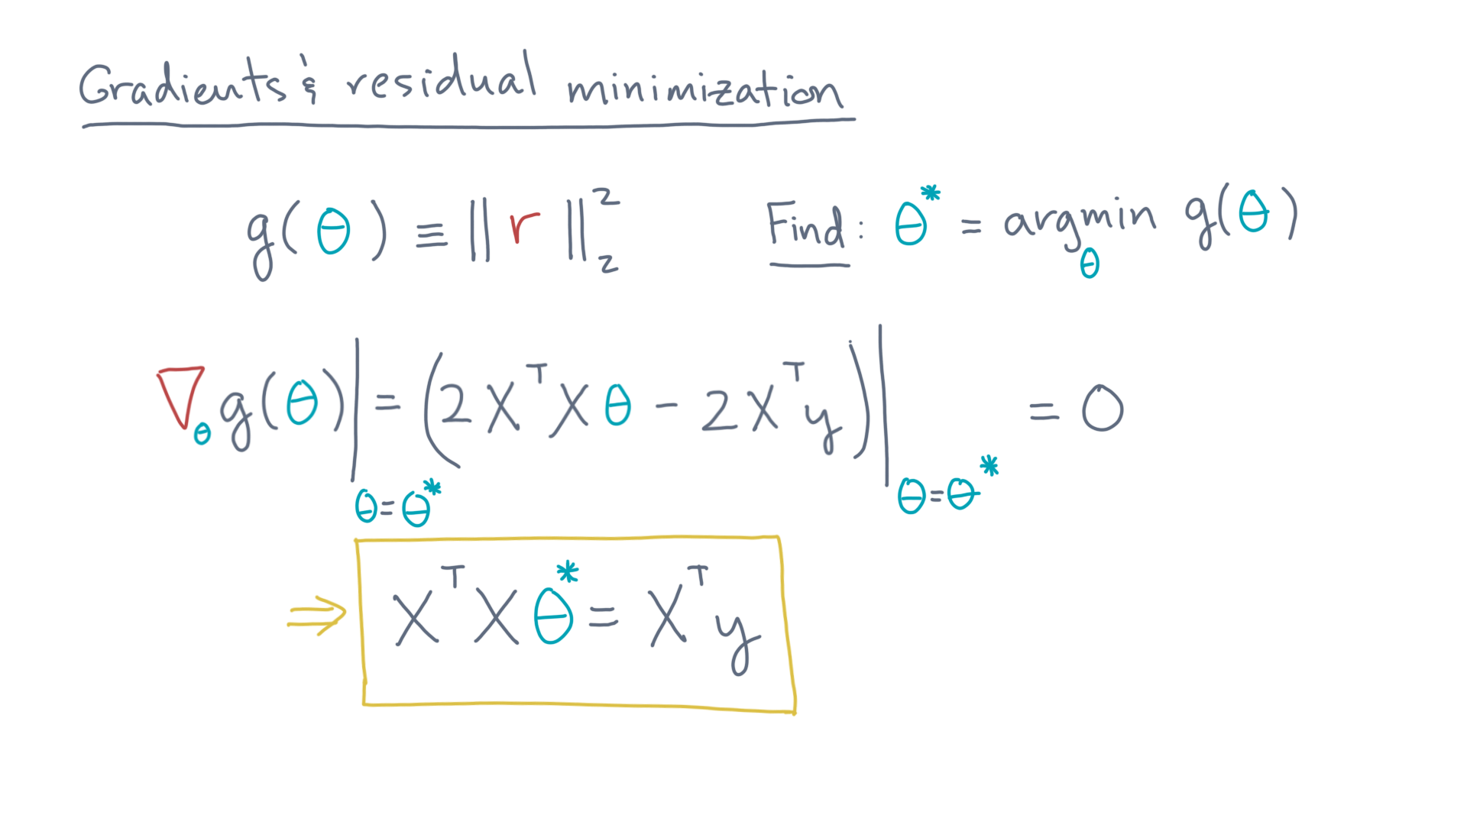
Notes:
And that theta-star must be the solution to this equation: X-transpose-X-times-theta-star equals X-transpose-y.

Slide 51
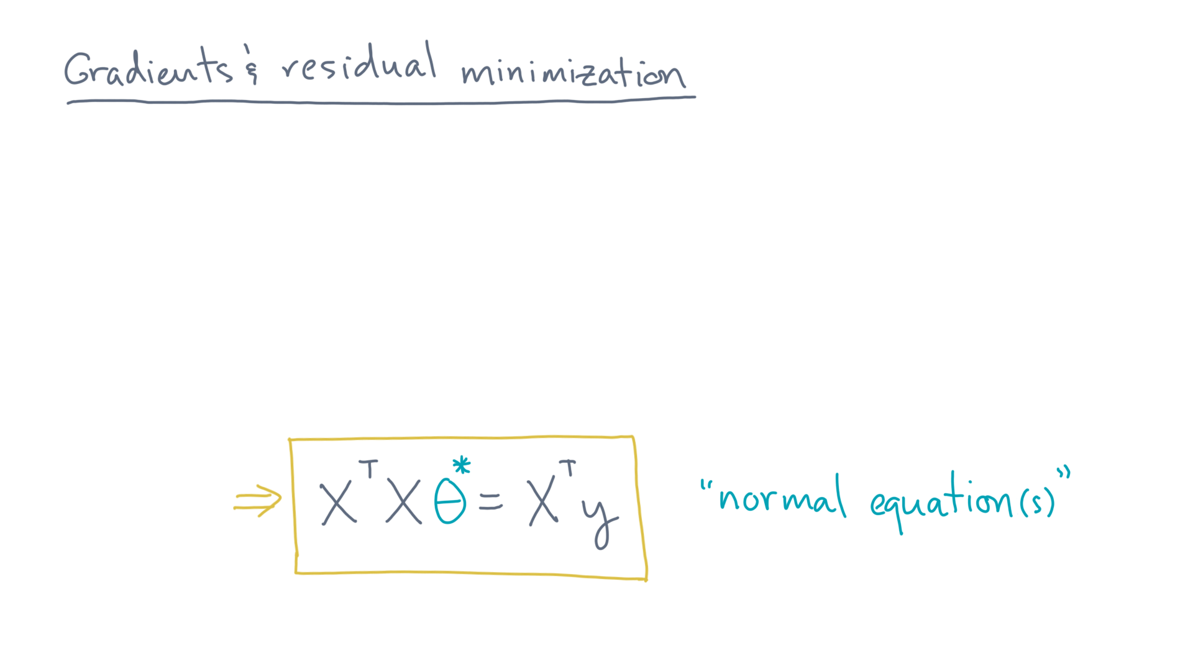
Notes:
This system is sometimes referred to as “the normal equation” (or sometimes “the normal equations,” plural, depending on your point of view).

Slide 52
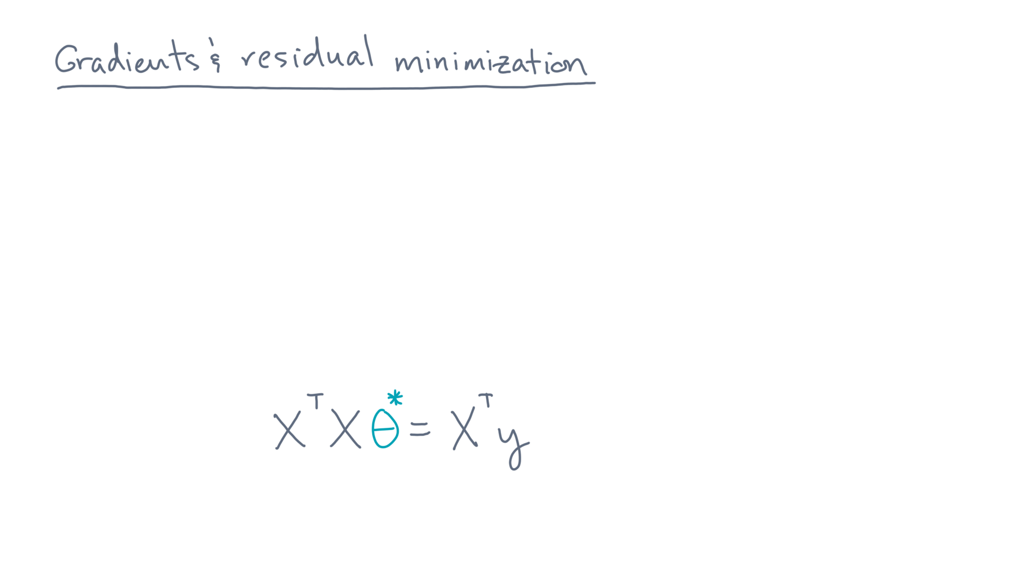
Notes:
Now let me suggest one final exercise.

Slide 53
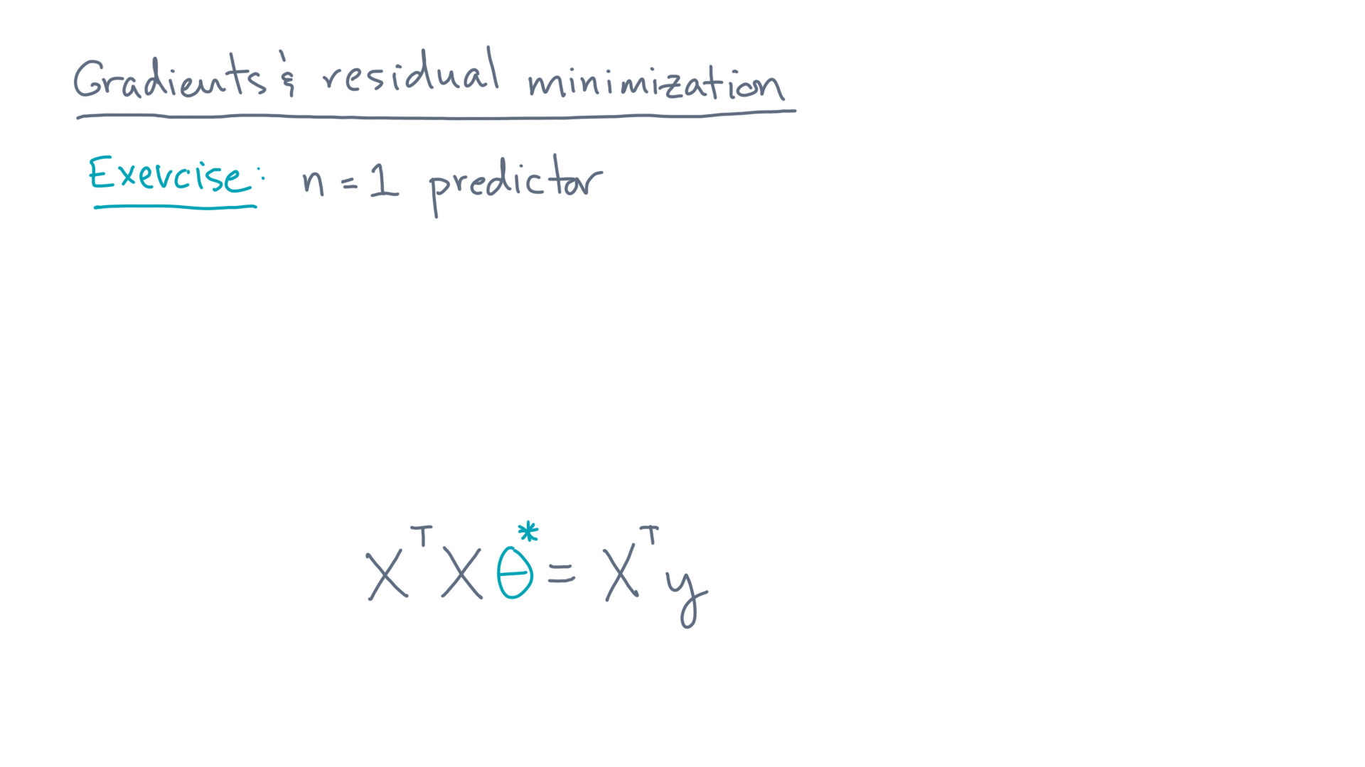
Notes:
Consider the case of a single predictor, or n equals 1.

Slide 54
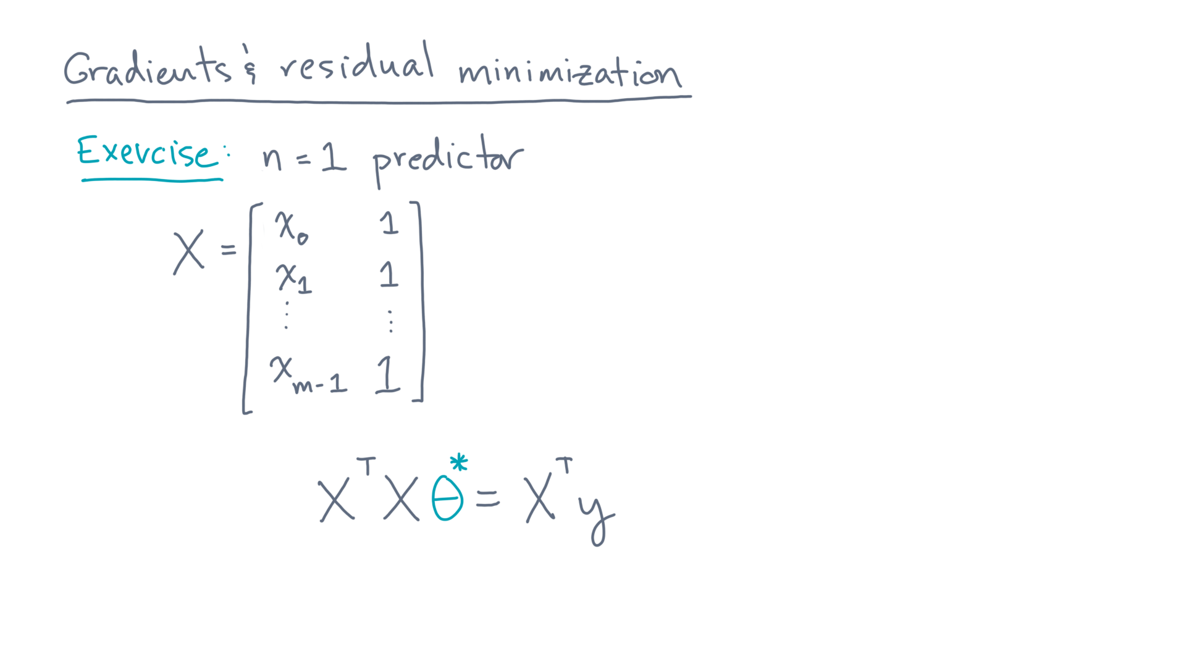
Notes:
In this case, the data matrix, capital-X, is just a single column of predictor values for each observation, along with an extra column of ones.

Slide 55

Notes:
Recall that this extra column allows our linear model to have an intercept term.

Slide 56

Notes:
Using “u” to denote this column of ones, capital-X has two columns: little-x for the predictor and u for the column of ones.

Slide 57

Notes:
In addition, theta is the two-component vector consisting of theta-zero and theta-one.

Slide 58

Notes:
From this starting point, plug capital-X and theta into the normal equations, and then determine theta-star.
How does it compare to our result from the other lesson that analyzed the single-predictor case?

Slide 59
Notes:
To summarize, this lesson was about building foundations, using the gradient, for solving the multiple linear regression problem.
And because it is based almost entirely on linear algebra, it should, at least in principle, lead to a compact and efficient solution.
However, there is still one big detail, namely, how exactly do you solve the normal equation?

Slide 60
Notes:
To walk you through that process, we’ve put together a couple Jupyter notebooks.
Take a moment to review what we just covered, and with that as background, you should have everything you need to get a working numerical algorithm for linear regression.

